Slide 1
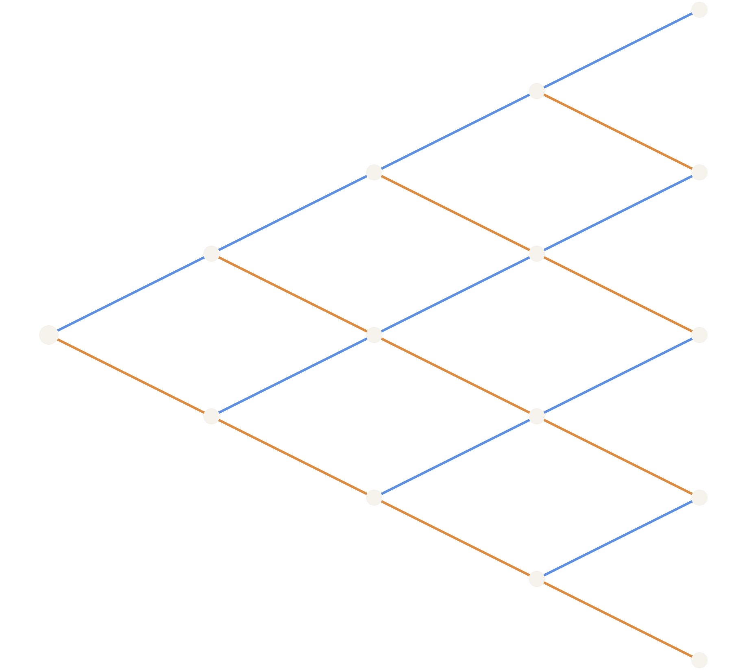
Pricing options on a lattice
OPTIONS FOUNDATIONS · LATTICE METHODS
An intuitive walk from “what is this contract worth?” to the binomial tree — and why that tree is Black-Scholes in discrete form
J. Persson 2026
Notes:
Welcome. The goal of this session is intuition, not stochastic calculus. By the end you should be able to price a European or American option with a few lines of code, explain why the real-world probability of an up-move does not enter the price, and see why the binomial lattice is nothing more than a discrete version of the Black-Scholes model. We use one small running example throughout: a stock at 100 that moves up 10% or down 10% each step.

Slide 2
Six stops on the way to a price
ROADMAP
00
Options 101
What an option is, what it is written on, why people use it — and how it has made and lost fortunes
01
The pricing problem
Payoffs, time value of money, why “expected payoff” fails, and the Black-Scholes answer
02
One step
Up with probability p, down with 1 − p — and why p drops out of the price
03
The lattice
Forward propagation of prices and probabilities; backward induction of values
04
Using the lattice
Hedging node by node, Greeks for free, American early exercise
05
Back to Black-Scholes
The backward step is a discretised PDE; the tree converges to the formula
Notes:
Here is the route. Stop zero is for anyone new to finance: what an option is, why it exists, and some history. Then we pose the pricing problem itself, then solve the smallest possible version of it — a single step — where the key insight lives. Then we stack steps into a lattice and show the two directions of travel: forward through the tree to generate prices and probabilities, backward through it to generate values. Finally we zoom out and show that as the steps shrink, the lattice becomes Black-Scholes.

Slide 3


Why should you care about options?
00 · OPTIONS 101
15.2 bn
In your pay slip
In production code
In the market
Employee stock options are call options on your employer’s shares: the right to buy at a fixed price, later.
Exchanges, brokers and banks price and risk-manage options all day — with exactly the models in this deck.
US option contracts cleared in 2025 — about 60 million a day, up 24% on 2024.
An option is a programmable promise: a payoff function, a deadline — and a price someone has to compute.
Source: OCC, annual volume report 2025 (published January 2026)
Notes:
Start with why this matters to people who write software. Many of you already hold options: employee stock option grants are call options on your employer's shares. The market is enormous: the Options Clearing Corporation, which clears all US-listed options, reported 15.2 billion contracts in 2025 — roughly 60 million per trading day, and growth of about 24% over 2024. And behind every one of those trades is code: pricing engines, risk systems, market-making bots. The binomial lattice and Black-Scholes, which we'll build today, are not academic curiosities — they run in production. Frame the session as: here is a contract, here is its payoff function, how do we compute a fair price?

Slide 4
Anatomy of an option: a right, not an obligation
00 · OPTIONS 101
struct OptionContract {
underlying: "ACME shares"
type: CALL | PUT
strike K: 100.00
expiry T: 2027-03-19
style: EUROPEAN | AMERICAN
premium: 5.20
}
Buyer (holder)
Pays the premium, gets the right. Exercises only if it pays. Worst case: loses the premium.
Seller (writer)
Collects the premium, carries the obligation. Worst case: large losses.
// CALL: right to BUY at K
// PUT: right to SELL at K
// EUROPEAN: exercise at T only
// AMERICAN: exercise any time up to T
// premium: paid today by the buyer
Call ≈ a price lock (like a deposit reserving a house at today’s price).
Put ≈ an insurance policy on what you own.
Notes:
Think of an option as a data structure. It names an underlying asset, whether it's a call — the right to buy — or a put — the right to sell, a strike price K, an expiry date T, and an exercise style: European options can only be exercised at expiry, American ones any time before. The buyer pays a premium up front; that premium is the number we want to compute. The asymmetry is the whole point: the holder has a right and walks away if exercising doesn't pay, so their loss is capped at the premium. The writer has the obligation, and that's why they demand payment. ACME and the numbers are illustrative. Everyday analogies help: a call is like paying a deposit to lock in a house price, a put is like an insurance policy on something you own.

Slide 5
The underlying: almost anything with a price
00 · OPTIONS 101
Single stocks
Indices & ETFs
Currencies
Shares of one company. A US contract covers 100 shares.
S&P 500, Euro Stoxx 50, OMXS30 — a bet or hedge on a whole market.
EUR/USD, USD/SEK — exporters lock in exchange rates.
Commodities
Interest rates
Volatility itself
Oil, gold, grain — usually options on futures contracts.
Caps, floors, swaptions — borrowers insure against rising rates.
VIX options — a bet on how much prices will move, not which way.
In this deck: one non-dividend-paying stock — the simplest underlying. Everything generalises.
2025 US cleared volume: single stocks 8.3 bn · ETFs 5.7 bn · indices 1.3 bn contracts (OCC)
Notes:
The underlying is the thing whose price drives the payoff. Most option volume is on equities: single stocks and stock indices or index-tracking ETFs. For a Swedish audience, OMXS30 index options are the local example. But the same idea applies to currencies, where exporters use options to protect against exchange-rate moves; to commodities, usually via options on futures; to interest rates, where caps and swaptions protect borrowers; and even to volatility itself through VIX options. The footer shows the 2025 split at the OCC: about 8.3 billion contracts on single stocks, 5.7 billion on ETFs, 1.3 billion on indices. For the rest of this session we'll use the simplest possible underlying: one stock paying no dividends.

Slide 6
Why use options? Insurance, leverage, income
00 · OPTIONS 101
Hedge
Speculate
Earn income
Own the stock, buy a put: your loss has a floor. A pension fund insuring its portfolio.
A small premium buys a large exposure: leverage, with the loss capped.
Sell calls on stock you own and collect premiums — giving away upside you didn’t expect.
Leverage in numbers — stock at 100; a call with K = 100 costs 5:
Stock moves to | Buy 1 share for 100 | Buy 1 call for 5
120 | +20 · +20% | +15 · +300%
100 | 0 · 0% | −5 · −100%
90 | −10 · −10% | −5 · −100%
Notes:
Three reasons people trade options. Hedging: if you own shares, a put is insurance — below the strike, every euro the stock loses, the put gains. Speculation: an option gives exposure to a large position for a small premium. Income: if you own shares and don't expect a big rise, you can sell calls and pocket the premium, accepting that someone else gets the upside. The table makes leverage concrete. If the stock goes from 100 to 120, the shareholder makes 20%; the call holder paid 5, receives 20, and makes 300%. But if the stock merely stays flat, the call buyer loses everything. That convex, lopsided payoff is exactly why the price is hard — and why it matters to get right.

Slide 7
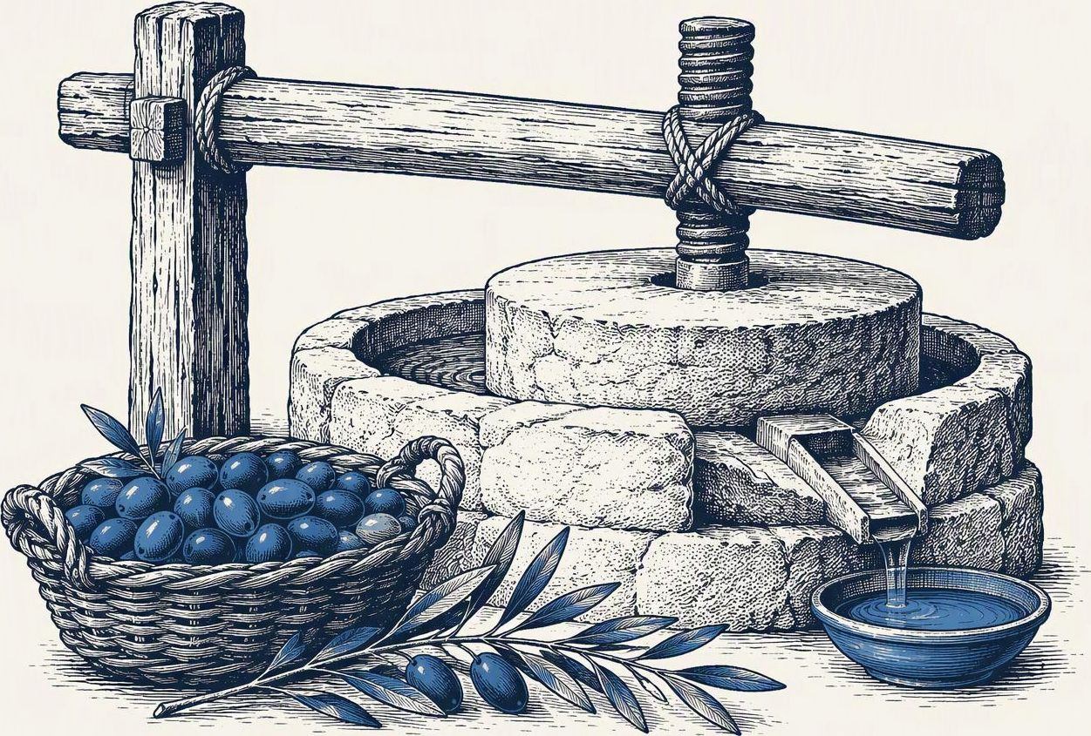
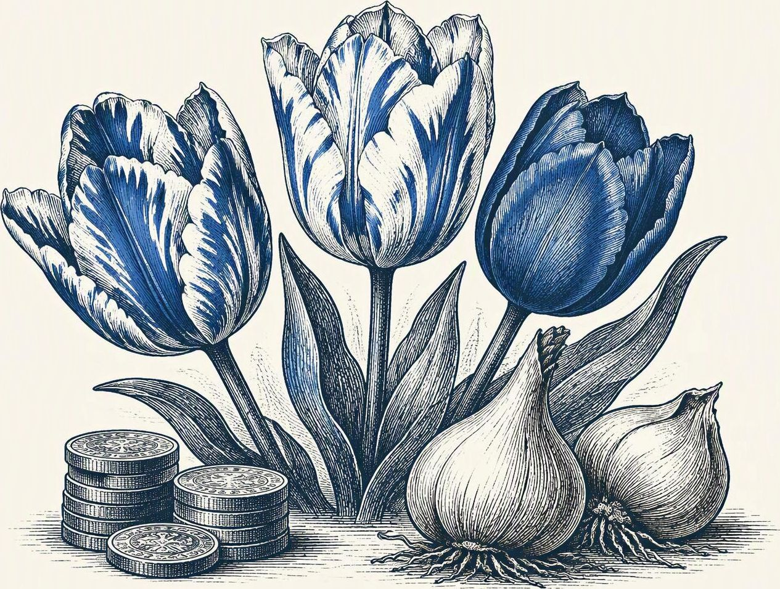
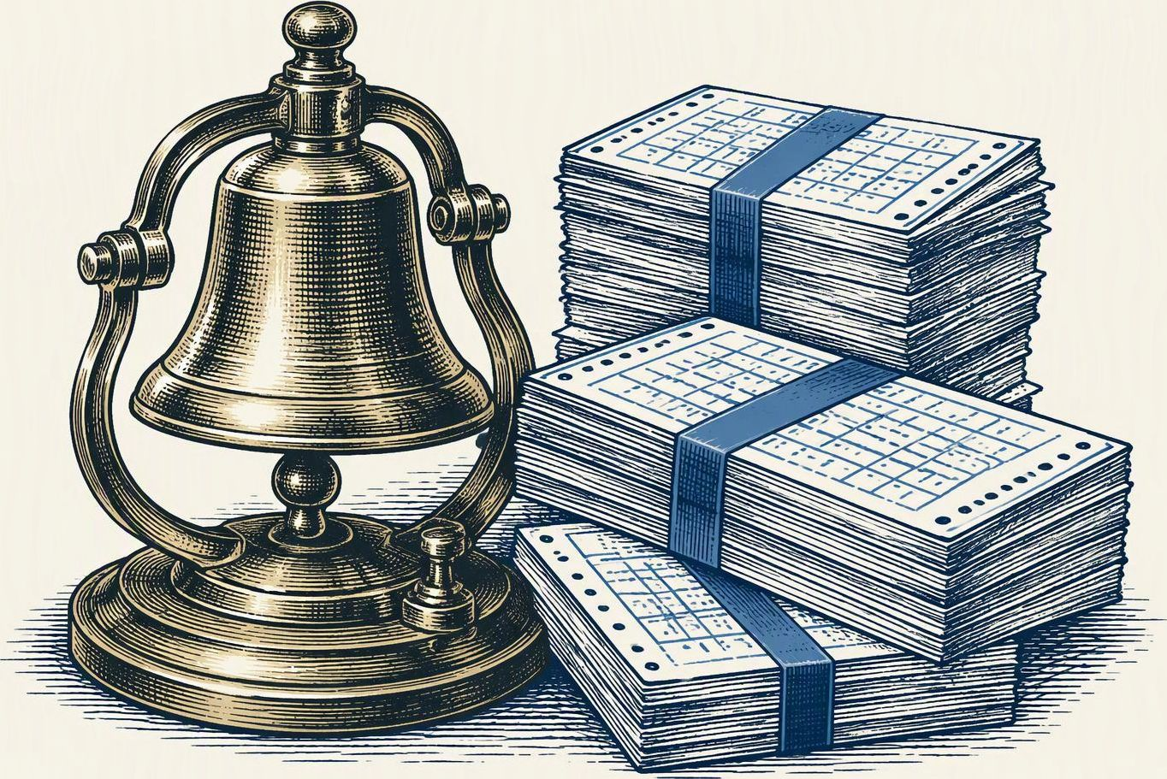

Options are older than stock markets
00 · OPTIONS 101 · HISTORY
~600 BC
1636–37
1870s
1973
Thales’ olive presses
Tulip mania
Russell Sage
CBOE opens
Aristotle tells how Thales of Miletus paid small deposits for the use of olive presses before a bumper harvest — then rented them out at a profit. The first recorded call option.
Dutch traders bought and sold the right to buy bulbs at fixed prices. When prices collapsed in February 1637, many contracts were never honoured in full.
A Wall Street financier combined puts, calls and stock into synthetic loans — using the put-call parity we will check later.
First exchange for standardised, centrally cleared stock options. Same year as the Black-Scholes paper. Today: ~60 million US contracts a day.
Notes:
Options are much older than the formulas that price them. Aristotle, in the Politics, tells the story of the philosopher Thales, mocked for being poor, who foresaw a good olive harvest and paid small deposits for the right to use the local olive presses. When the harvest came, demand for presses soared and he rented them out at whatever price he liked — a call option on press capacity.
In the Dutch tulip mania of the 1630s, much of the trade was in contracts to buy bulbs later at fixed prices; when prices crashed in February 1637, many of those contracts were never honoured in full.
In the 1870s the financier Russell Sage combined options and stock to create synthetic loans — an early practical use of put-call parity.
In 1973 the Chicago Board Options Exchange opened, standardising contracts and clearing them centrally — the same year Black and Scholes published. That combination of a liquid market and a pricing formula is what made options a mass-market product.

Slide 8
…and they have blown up spectacularly
00 · OPTIONS 101 · HISTORY
1987 · Black Monday
1995 · Barings Bank
“Portfolio insurance” copied a put by selling stock as prices fell — the very hedge we’ll build. Everyone sold at once: the Dow fell 22.6% on 19 October.
Trader Nick Leeson sold Nikkei options betting on calm markets. The Kobe earthquake hit; losses of £827m sank a 233-year-old bank.
1998 · LTCM
2021 · GameStop
A hedge fund with Merton and Scholes on its board lost $4.6bn in under four months. The New York Fed brokered a $3.6bn rescue by 14 firms.
Retail traders bought calls en masse. Dealers hedging them had to buy shares, pushing the price higher still — a “gamma squeeze”.
Lesson: the model is a tool. Its assumptions are where the bodies are buried.
Notes:
Options also have a dramatic track record. In October 1987, many institutions ran portfolio insurance: a strategy that synthetically creates a put by selling stock as prices fall — exactly the dynamic hedge we'll derive from the lattice. When everyone tried to sell at once, the hedge itself fed the crash; the Dow lost 22.6 percent in a single day. In 1995 Nick Leeson at Barings sold Nikkei straddles, essentially betting the Japanese market would stay calm; the Kobe earthquake in January sent it lurching, and the losses of about 827 million pounds brought down a bank founded in 1762. In 1998 Long-Term Capital Management, whose board included Robert Merton and Myron Scholes, a year after their Nobel prize, lost 4.6 billion dollars in under four months; the New York Fed brokered a 3.6 billion dollar recapitalisation by fourteen firms. And in 2021 GameStop showed delta hedging in reverse: dealers who sold calls to retail traders had to buy stock as it rose, pushing it higher still. The message for engineers: the mathematics is sound, but every model rests on assumptions — continuous trading, no jumps, liquid markets — and the disasters happen when those break.

Slide 9

Black Monday: hedging into a falling market
00 · OPTIONS 101 · HISTORY
19 OCTOBER 1987
−22.6%
Dow Jones decline in one trading session
BACKGROUND
Portfolio insurance sought to mimic a protective put by cutting equity exposure as markets fell.
FEEDBACK LOOP
Simultaneous selling added pressure to falling prices. Trading systems and liquidity struggled under the volume.
AFTERMATH
The Fed supplied liquidity. Exchanges later introduced circuit breakers to pause rapid sell-offs.
A hedge depends on the ability to trade when markets move.
https://www.federalreservehistory.org/essays/stock-market-crash-of-1987
https://www.federalreserve.gov/pubs/feds/2007/200713/
https://www.nber.org/system/files/chapters/c10958/c10958.pdf
Notes:
Portfolio insurance was one contributor, not a complete single-cause explanation. The options-pricing lesson is an interpretation: continuous rebalancing assumes executable trades and sufficient liquidity.
[Sources]
https://www.federalreservehistory.org/essays/stock-market-crash-of-1987
https://www.federalreserve.gov/pubs/feds/2007/200713/
https://www.nber.org/system/files/chapters/c10958/c10958.pdf
[/Sources]

Slide 10

Barings Bank: hidden trades, failed controls
00 · OPTIONS 101 · HISTORY
FEBRUARY 1995
£827m
Reported trading losses
BACKGROUND
Nick Leeson took unauthorised futures and options positions in Singapore while overseeing both trading and settlement.
HIDDEN EXPOSURE
He concealed losses in an error account. The Nikkei decline after the Kobe earthquake worsened the damage.
OUTCOME
Barings entered administration on 26 February. ING subsequently acquired the bank for £1.
Independent controls matter as much as a pricing model.
https://www.rba.gov.au/publications/bulletin/1995/nov/1.html
https://www.britannica.com/event/bankruptcy-of-Barings-Bank
Notes:
The original deck reports £827 million; Britannica rounds the loss to roughly £830 million. Futures as well as options mattered. The failure involved unauthorised positions and ineffective supervision, not simply an incorrect volatility forecast.

Slide 11
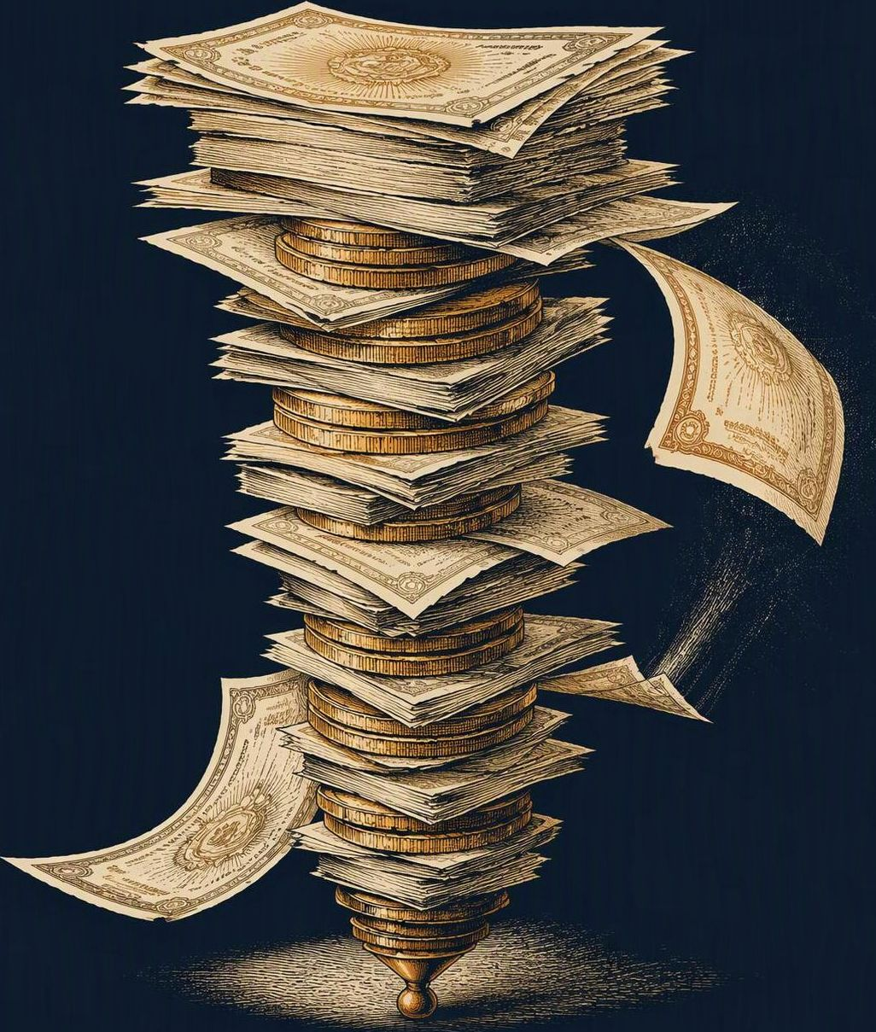
LTCM: leverage magnified model risk
00 · OPTIONS 101 · HISTORY
SEPTEMBER 1998
$3.6bn
Private rescue funded by 14 financial firms
BACKGROUND
Founded in 1994, Long-Term Capital Management used models to trade price differences between similar securities.
STRESS
High leverage amplified losses during the Asian and Russian financial crises. Turbulent markets made a forced sale dangerous.
RESCUE
The New York Fed convened creditors. Their capital injection allowed an orderly unwind without Fed money at risk.
Modelled value cannot guarantee funding or market liquidity.
https://www.federalreservehistory.org/essays/ltcm-near-failure
https://en.wikipedia.org/wiki/Long-Term_Capital_Management
Notes:
The rescue occurred on 23 September 1998. Distinguish a Fed-facilitated private recapitalisation from a publicly financed bailout. The lesson is an interpretation about leverage and liquidity, not a claim that Black-Scholes alone caused the failure.

Slide 12

GameStop: a rally with disputed mechanics
00 · OPTIONS 101 · HISTORY
JANUARY 2021
Retail surge
Social attention met heavy short interest
BACKGROUND
Retail interest and social-media attention surged alongside GameStop’s share price and trading volume.
MARKET FRICTION
Several brokers temporarily restricted trading. The episode raised questions about clearing, settlement and short selling.
EVIDENCE CHECK
SEC staff found no evidence of a January gamma squeeze. Some academics dispute the analysis, so the explanation remains contested.
Gamma hedging is a mechanism, not proof of what drove a rally.
https://www.sec.gov/newsroom/press-releases/2021-212
https://www.sec.gov/files/staff-report-equity-options-market-struction-conditions-early-2021.pdf
https://clsbluesky.law.columbia.edu/2022/02/22/an-academic-critique-of-the-secs-gamestop-report/
https://www.shacknews.com/article/127195/sec-issues-gamestop-gme-report-on-what-happened-in-january-2021
Notes:
This slide qualifies the simplified gamma-squeeze explanation on original slide 8, which remains unchanged. SEC staff attributed the sustained rise primarily to positive investor sentiment rather than short covering and did not find evidence of a gamma squeeze in January. A 2022 academic critique argues that broader data and put-and-call dealer hedging support a different interpretation. A short-gamma dealer may need to buy shares as prices rise, but actual positioning and flows determine the effect.

Slide 13
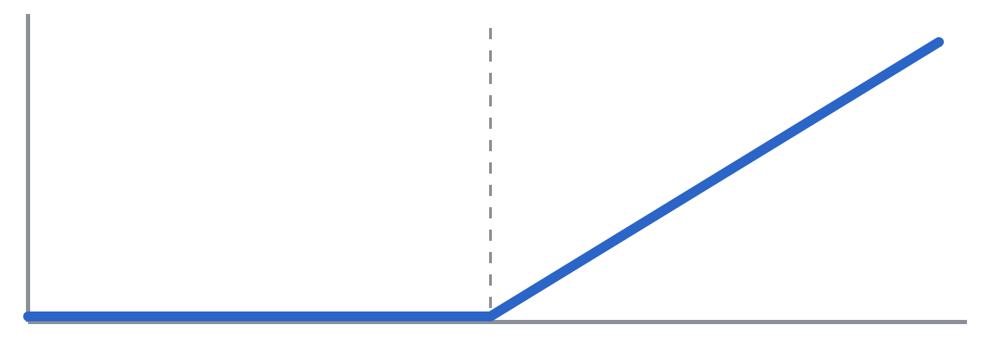
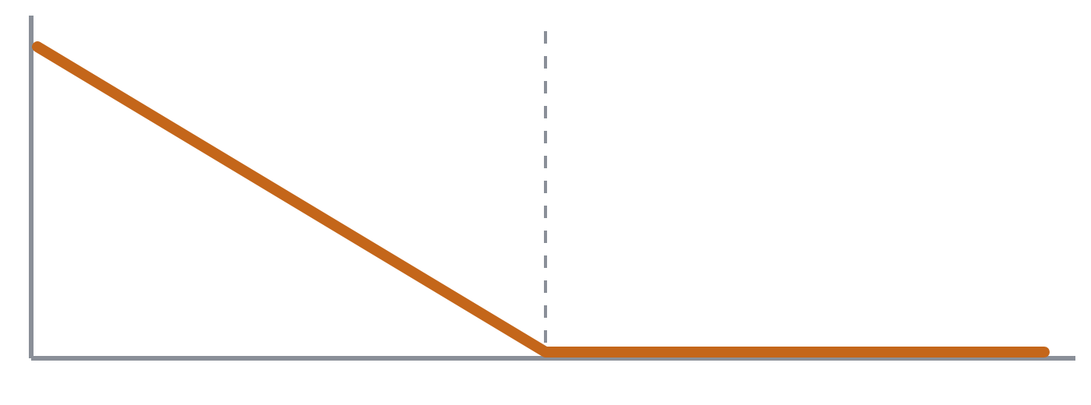
An option is a payoff function of a future price
00 · OPTIONS 101 · PAYOFF
Call option
Put option
The right — not the obligation — to buy the stock at strike K on expiry date T.
The right — not the obligation — to sell the stock at strike K on expiry date T.
K
K
S(T)
S(T)
payoff = max(S(T) − K, 0)
payoff = max(K − S(T), 0)
Notes:
Two contracts carry the whole talk. A call pays the amount by which the stock ends above the strike; a put pays the amount by which it ends below. The hockey-stick shape is the important part: the payoff is a known, deterministic function of one unknown number, the stock price at expiry. Horizontal axis is S(T), vertical axis is payoff; the dashed line marks the strike K. Note the asymmetry: you can't lose more than what you paid for the option, which is exactly why it has value today.

Slide 14
Delta and gamma describe how option value moves
00 · OPTIONS 101 · DELTA AND GAMMA
The payoff tells us what the option pays at expiry. Before expiry, its value V changes as the stock price S moves.
Delta: how much does option value move?
Gamma: how much does delta change?
Delta measures the local change in option value for a small change in the stock price.
Delta itself changes as the stock moves. Gamma measures how quickly it changes.
With delta 0.50, a small $1 rise in the stock adds about $0.50 to the option’s value.
That changing sensitivity explains why a stock hedge needs rebalancing.
The next curves show delta and gamma for a call option before expiry.

Slide 15
Gamma measures how quickly delta changes
00 · OPTIONS 101 · GAMMA HEDGING
Delta Δ = ∂V/∂S is price sensitivity. Gamma Γ = ∂Δ/∂S = ∂²V/∂S² is its slope.
CALL DELTA (shares per option share)
CALL GAMMA (delta change per $1)
Underlying stock price S ($)
Underlying stock price S ($)
Stock can offset delta but has zero gamma. Gamma-neutral hedging adds options with offsetting curvature.
Illustrative Black–Scholes model: European calls, K = $100, volatility = 20%, r = q = 0, 365-day year.
Notes:
Both plots show a long call at one instant. Stock price varies while maturity and volatility remain fixed. Long vanilla calls and puts have positive gamma; short positions have negative gamma. Gamma typically concentrates near the strike as expiry approaches, rather than rising everywhere. Delta-change approximation: dDelta ≈ Gamma*dS. Gamma-neutrality is local, not permanent.
[Sources]
https://www.optionseducation.org/advancedconcepts/gamma
https://www.optionseducation.org/advancedconcepts/understanding-options-greeks
https://www.macroption.com/delta-hedging/
https://www.strike.money/options/gamma-hedging
[/Sources]

Slide 16
How to read the delta and gamma curves
00 · OPTIONS 101 · GAMMA HEDGING
THE VARIABLES
THE DELTA AND GAMMA FIGURES
V · Option value
Left: delta rises from near 0 to near 1
The call’s current value in dollars per underlying share. A 100-share contract is worth 100 × V.
Far below the $100 strike, the call reacts weakly to stock moves. Far above it, it behaves like one share. The 30-day curve rises more steeply near the strike.
S · Stock price
The current price of one underlying share, in dollars. Both figures use S on the horizontal axis.
Right: gamma measures that steepness
Gamma is highest near the strike, where delta changes fastest. The blue 30-day peak is taller and narrower than the orange 90-day peak. Far from the strike, both approach zero.
Δ · Delta = ∂V/∂S
The local slope of V versus S. With Δ = 0.50, a small $1 rise in S adds about $0.50 to V.
A snapshot with other inputs held fixed
Γ · Gamma = ∂Δ/∂S
Each curve varies only S. Blue means 30 days to expiry, orange 90 days. These are separate maturities, not a stock-price path through time. Short calls reverse the signs of both Greeks.
The local slope of the delta curve, or curvature of V. Γ = 0.07 means about 0.07 more delta per $1 rise in S, locally.
For a small stock move: change in V ≈ Δ × change in S; change in Δ ≈ Γ × change in S.
∂ means “change one input, hold the others fixed”. Same assumptions as the figures: K = $100, volatility 20%, r = q = 0.
Notes:
Companion reading guide to slide 13. V denotes the long call premium per underlying share, not an expiry payoff or full contract premium. Delta is equivalent shares per option share. Gamma has units inverse dollars when V and S are quoted per share. The first-order examples are local approximations, not exact predictions for a finite move. At S=100 the 30-day model has delta about .5114 and gamma .06955. Delta is not generally the risk-neutral exercise probability. The gamma peak is near, not necessarily exactly at, the strike. Strike K is fixed at $100, r is the continuously compounded risk-free rate, and q the dividend yield. Existing slide 13 model and sources supply the explanation.
[Sources]
https://www.optionseducation.org/advancedconcepts/gamma
https://www.optionseducation.org/advancedconcepts/understanding-options-greeks
Existing slide 13 and its embedded Black–Scholes chart data.
[/Sources]

Slide 17
A short-gamma stock hedge buys into a rise
00 · OPTIONS 101 · GAMMA HEDGING
Dealer is short 100 calls, each on 100 shares, with 30 days remaining. Stock hedge H = 10,000 × Δ.
STOCK REQUIRED FOR DELTA NEUTRALITY
Stock | Call Δ | Hedge shares
$95 | 0.1933 | 1,932.71
$100 | 0.5114 | 5,114.36
$105 | 0.8105 | 8,104.59
$100 to $105: buy 2,990.23 more shares.
$100 to $95: sell 3,181.65 shares.
Underlying stock price S ($)
This rebalances delta while gamma remains negative. A long-gamma hedge trades in the opposite direction.
Same model as prior slide. Instantaneous scenarios, not a time path. Time and volatility fixed. Theoretical shares shown to two decimals.
Notes:
The dealer has only the specified short-call position plus stock. Signed portfolio gamma at S=100 is -100*100*Gamma_call. Rebalancing the stock resets portfolio delta but leaves gamma unchanged. Values are exact model recalculations, not constant-gamma extrapolations. Scenarios at $95 and $105 are separate moves from $100. Such flows can reinforce price moves, but price impact depends on actual dealer positioning and market liquidity; this is not a claim about GameStop.
[Sources]
https://www.optionseducation.org/advancedconcepts/gamma
https://www.optionseducation.org/advancedconcepts/understanding-options-greeks
https://www.macroption.com/delta-hedging/
https://www.strike.money/options/gamma-hedging
Numerical figures: internally calculated illustrative Black–Scholes values; not market observations.
[/Sources]

Slide 18
An options hedge can offset gamma locally
00 · OPTIONS 101 · GAMMA HEDGING
At S = $100: offset the short 30-day calls with 90-day calls, then use stock to remove the remaining delta.
nᴮ = −Γᴬ / (100 × Γᴮ)
H = −(Δᴬ + nᴮ × 100 × Δᴮ)
INSTANTANEOUS REVALUATION P/L ($)
A: signed original portfolio. B: one share of the 90-day call.
Position | Quantity | Delta¹ | Gamma²
30-day call | −100 | -5,114.36 | -695.48
90-day call | +173.347 | 9,010.64 | 695.48
Stock | -3,896.28 | -3,896.28 | 0.00
Total |  | 0.00 | 0.00
Options: contracts × 100. ¹ Delta: shares. ² Gamma: shares/$.
Fractional hedge quantities. Totals use unrounded values.
Underlying stock price S ($)
Neutral only at the calibration point. Time decay, volatility changes, larger moves and trading costs still matter.
Notes:
Model assumptions: Illustrative Black–Scholes model: European calls, K = $100, volatility = 20%, r = q = 0, 365-day year. Short 100 contracts of 30-day calls, long n_B contracts of 90-day calls, contract multiplier m=100. Signed original portfolio Delta_A=-10000*delta_A and Gamma_A=-10000*gamma_A. Hedge count n_B=-Gamma_A/(m*gamma_B); stock H=-(Delta_A+n_B*m*delta_B). Table quantities are theoretical and fractional; real whole-contract rounding leaves residual risk. Chart uses exact Black–Scholes revaluation with time and implied volatility fixed, no financing costs, spreads, transaction costs or premium-carry effect. A cash balance can finance initial premiums without changing instantaneous delta/gamma. P/L is change from each portfolio own initial value. It is not realised trading profit. Both delta and gamma vanish locally at S=100; higher-order and cross-Greek risks remain. At the stated zero-rate flat-vol model point, gamma neutrality also offsets theta locally, but this does not generalise to all portfolios or changing volatility.
[Sources]
https://www.optionseducation.org/advancedconcepts/gamma
https://www.optionseducation.org/advancedconcepts/understanding-options-greeks
https://www.macroption.com/delta-hedging/
https://www.strike.money/options/gamma-hedging
Numerical figures: internally calculated illustrative Black–Scholes values; not market observations.
[/Sources]

Slide 19

The question: what is that payoff worth today?
01 · THE PRICING PROBLEM
Inputs
S₀ stock price now
K strike
T time to expiry
r risk-free rate
σ volatility
Pricing model
Output
V₀
Black-Scholes formula, or a binomial lattice
one fair price today
The payoff rule is known exactly. The only unknown is the path the stock takes until T. A pricing model is a disciplined way of turning uncertainty about the future into a single number now.
Notes:
Frame it as an engineering interface. Five inputs go in, one number comes out. Notice what is NOT on the input list: the expected return of the stock, or anyone's opinion of where it is heading. That absence is the big surprise of option pricing, and the one-step tree will show us why it's legitimate. Volatility, sigma, is the only input that is not directly observable; in practice it is often backed out of market prices — the implied volatility.

Slide 20


Time value of money: 100 today beats 100 next year
01 · THE PRICING PROBLEM · STEP 1 OF 3
today
after 1 step
after 2 steps
after 3 steps
100.00
102.00
104.04
106.12
discounting = compounding run backwards: 106.12 in 3 steps is worth 100 today
Compound (forward)
Discount (backward)
FV = PV · Rⁿ
PV = FV / Rⁿ
R = 1.02 (<-> 2%) per step: what a risk-free deposit or government bond pays.
In continuous time: PV = FV · e^(−rT). Same idea, smaller steps.
Notes:
The pricing recipe has three ingredients and this is the first. Money has a time value: 100 today can be put in a risk-free deposit and grows to 102 after one step at 2 percent, 104.04 after two, 106.12 after three — compounding. Turn that around: a promise of 106.12 three steps from now is worth exactly 100 today, because 100 in the bank produces it. That reverse operation is discounting: divide by R once per step. For developers: compounding and discounting are inverse functions. The rate we use here is the risk-free rate — what a government bond or an insured deposit pays with no risk of default. In continuous-time models like Black-Scholes the discount factor is written e to the minus r T; it's the limit of many tiny compounding steps. Keep this picture in mind: discounting is a backward walk in time, exactly what we'll do through the lattice.

Slide 21
Where the average comes from: probability-weighted payoffs
01 · THE PRICING PROBLEM · STEP 2 OF 3
The developer’s version: simulate many futures, average the payoffs (Monte Carlo).
A coin-flip game
Heads pays 10, tails pays 0, fair coin. Played many times, you win on average:
N = 1_000_000
payoffs = [max(simulate_S_T() - K, 0) for _ in range(N)]
expected = sum(payoffs) / N
0.5 · 10 + 0.5 · 0 = 5
In general: the expected value
Law of large numbers: as N grows, the sample mean converges to E[payoff].
E[X] = Σ pᵢ · xᵢ
Each outcome xᵢ weighted by its probability pᵢ. The weights sum to 1.
The catch: the result is only as good as the probabilities inside simulate_S_T().
Notes:
Second ingredient: the average. If a game pays 10 on heads and nothing on tails, and you play it many times, you'll average 5 per game. That's the expected value: each outcome weighted by its probability. For an option the outcomes are the payoffs in the different possible future stock prices. Developers often meet this as Monte Carlo simulation: generate a million random future stock prices, compute the payoff of each, take the mean. The law of large numbers guarantees that average converges to the expected payoff. Monte Carlo pricing is a real industrial technique. But notice the catch, in orange: the answer depends entirely on the probabilities your simulator uses. Hold that thought.

Slide 22
Put together: the “discounted expected payoff” recipe
01 · THE PRICING PROBLEM · STEP 3 OF 3
Example: a stock at 100 will be at 110 or 90 one period from now. A call with K = 100. Risk-free growth R = 1.02.
# | Step | Our example
1 | List the possible futures | S = 110 or S = 90
2 | Payoff in each future | max(110−100,0)=10 · max(90−100,0)=0
3 | Assign probabilities (a forecast) | p = 0.7 up · 1 − p = 0.3 down
4 | Average: expected payoff | 0.7·10 + 0.3·0 = 7.00
5 | Discount to today | 7.00 / 1.02 = 6.86
Looks sensible ... but .. soon we will see that at 6.86, someone else makes free money (and that we don't like!)
Notes:
Now assemble the two ingredients into the recipe almost everyone invents on their own. List the possible future stock prices; here, deliberately simple, 110 or 90. Compute the option payoff in each: 10 or nothing. Attach probabilities — say you believe there's a 70 percent chance of the up move. Take the probability-weighted average: 7. Then, because the 7 arrives one period from now, discount it back with the time value of money: 6.86. This is a perfectly reasonable-looking computation, and we'll keep this exact example — 100, 110, 90, 1.02 — for the rest of the session. The punchline, which we'll prove shortly, is that 6.86 is the wrong price: anyone who sells you the option at 6.86 can lock in a riskless profit.

Slide 23
Why the recipe breaks: two inputs nobody agrees on
01 · THE PRICING PROBLEM
V₀ = Eᵖ[ payoff ] / (1 + μ)ᵀ ← ?
Whose probability p?
Which discount rate μ?
Many prices
The real chance of an up-move is unobservable. A bull and a bear would plug in different values.
An option is riskier than the stock — and its riskiness changes as the price moves. No single rate fits.
Different opinions give different “fair” values. A market needs one price that everyone can agree on.
We will keep p in the model — and watch it disappear.
Notes:
This is what most engineers try first, and it is not crazy: price equals discounted expected value is the right shape. The problem is the two ingredients. The real-world probability p is a matter of opinion, and the right risk-adjusted discount rate for an option is neither the stock's rate nor constant. People spent decades on this before 1973. The breakthrough was realising you can avoid both questions entirely. Keep p in your head — we'll carry it into the one-step model and show it cancels out.

Slide 24
Arbitrage locks in a gain without a market bet
01 · THE PRICING PROBLEM · ARBITRAGE
The intuition: buy something cheaply and simultaneously sell an identical claim for more. The matching positions cancel the future risk.
VENUE A: BUY ONE SHARE
VENUE B: SELL THE SAME SHARE
LOCKED-IN DIFFERENCE
$99
$101
$2
The sale brings in $101 and the purchase costs $99, leaving $2.
The purchased share fulfils the sale’s delivery obligation, so no stock-price exposure remains once both trades are locked in
Buying at $99 and hoping to sell at $101 tomorrow leaves price risk. That is speculation.
Formal idea: zero initial net investment, no possible loss, and a positive probability of profit.
Illustrative quotes. Same security and settlement; simultaneous execution; no fees, taxes, funding or delivery risk.
Notes:
Illustrative numbers only. Identical fungible securities with same settlement and executable ask $99 / bid $101. Matching purchase and sale leaves +$2 immediately and no residual asset exposure. Assume financing/settlement arrangements permit execution without net capital contribution. If investing the initial gain, it fits the formal zero-initial-wealth terminal-profit definition. Real bid–ask spreads, financing, short-sale or transfer constraints and execution risk may eliminate the opportunity.
[Sources]
https://metaphor.ethz.ch/x/2021/hs/401-3913-01L/auth/lethz/notes/lectures/MFF_Chapter2.pdf
https://people.hec.edu/lovo/wp-content/uploads/sites/28/2025/12/Opt_binomial1.pdf
https://sungchullee.github.io/financial_math_book_writing/ch01/binomial_model/replicating_portfolio/
[/Sources]

Slide 25
No-arbitrage means matching payoffs have one price
01 · THE PRICING PROBLEM · ARBITRAGE
No-arbitrage rules out a free-profit strategy. If two tradable portfolios deliver identical cash flows in every state, their prices today must match.
Illustrative claim | Price today | Up-state payoff | Down-state payoff
A: cheaper claim | $5 | $10 | $0
B: dearer claim | $6 | $10 | $0
Buy A, sell B | Receive $1 | $0 net | $0 net
Why the gap closes
Buying A and selling B puts upward pressure on A and downward pressure on B.
What must match
Every payoff, payment date, currency and credit risk. Equal expected payoffs are insufficient.
Illustrative frictionless example. Shorting and financing allowed. “No-arbitrage” is a consistency condition, not a forecast.
Notes:
Formal no-arbitrage definition and law of one price. Claims A and B have identical state-contingent cash flows and payment dates, with identical counterparty/default risk. Buying A and selling B raises $1 at inception; future assets and obligations offset state by state. After investing the gain this yields a conventional arbitrage. Equal means alone do not imply equal prices. In incomplete markets no-arbitrage can imply a range rather than a unique derivative price; a unique price follows here because the payoff is replicable. The example does not assert claims must be worth $5 or $6 individually.
[Sources]
https://metaphor.ethz.ch/x/2021/hs/401-3913-01L/auth/lethz/notes/lectures/MFF_Chapter2.pdf
https://people.hec.edu/lovo/wp-content/uploads/sites/28/2025/12/Opt_binomial1.pdf
https://sungchullee.github.io/financial_math_book_writing/ch01/binomial_model/replicating_portfolio/
[/Sources]

Slide 26
The Options–Shares–Cash triangle
01 · THE PRICING PROBLEM · ARBITRAGE
THREE WAYS TO READ ONE IDENTITY
OPTIONS
C
1. Build the option
C = ΔS + B
Shares plus a bank position.
2. Build the share position
C = ΔS + B
ΔS = C − B
Option plus opposite cash.
SHARES
Δ × S
CASH
B
3. Build the cash position
B = C − ΔS
Option minus matching shares.
B > 0 means a deposit. B < 0 means borrowing.
Δ is the number of shares per option payoff unit.
Exact for the next slide’s one-period, two-state model. Use signed, scaled positions; arbitrary holdings are not equivalent.
Notes:
C is today’s option value per underlying share; S is today’s stock price; Delta is a chosen hedge ratio; B is the signed bank balance today. At expiry: C_state=Delta*S_state+R*B in each state. This exact identity follows by solving the two payoff equations, not by equating arbitrary asset holdings. Rearrangement yields the other two expressions. To replicate one share divide by Delta only if Delta is nonzero. Any two independent payoff vectors span the two-state model. Degenerate options may not span with cash or stock, so “any two always reproduce the third” is not universal. Across many steps the hedge changes at each node and must be self-financing; in continuous models exact replication also requires stronger assumptions. Diagram is native editable text and connectors, not an illustration asset.
[Sources]
https://metaphor.ethz.ch/x/2021/hs/401-3913-01L/auth/lethz/notes/lectures/MFF_Chapter2.pdf
https://people.hec.edu/lovo/wp-content/uploads/sites/28/2025/12/Opt_binomial1.pdf
https://sungchullee.github.io/financial_math_book_writing/ch01/binomial_model/replicating_portfolio/
[/Sources]

Slide 27
Half a share and a loan reproduce the call
01 · THE PRICING PROBLEM · ARBITRAGE
Same example as earlier: S₀ = $100, next-period stock $110 or $90, call strike K = $100, and cash grows by R = 1.02.
Position per option share | Today | Stock at $110 | Stock at $90
Buy 0.5 share | $50.00 | $55.00 | $45.00
Borrow $44.12 | −$44.12 | −$45.00 | −$45.00
Shares + loan | $5.88 | $10.00 | $0.00
Call option | $5.88 by no-arbitrage | $10.00 | $0.00
The other sides of the triangle
0.5 share − call = cash paying $45.
2 calls + cash paying $90 = 1 share.
If the call costs $6.86
Sell it and buy the $5.88 replica.
Keep about $0.98 today; future net payoff is $0.
Illustrative exact two-state model. No dividends or costs; borrowing and shorting allowed. Values round to cents.
Notes:
Computed: Delta=(10-0)/(110-90)=0.5. B=(0-0.5*90)/1.02=-44.117647058824. C=0.5*100+B=5.882352941176. Up and down replication payoffs are exactly 10 and 0. No-arbitrage stock/bank condition is 90<100*1.02<110. If quoted call price is 6.86, selling it and buying the replica gives 0.977647058824 today and zero net future payoff in either state. Costs and market frictions excluded. Half a share minus one call yields 45 in both states, current value 45/1.02=44.117647; two calls plus a deposit of 90/1.02=88.235294 reproduce one share. All call quantities are payoff units per underlying share, not 100-share exchange contracts. No real-world probability assumption is needed. The replicated value follows model assumptions and need not represent a real quote.
[Sources]
https://metaphor.ethz.ch/x/2021/hs/401-3913-01L/auth/lethz/notes/lectures/MFF_Chapter2.pdf
https://people.hec.edu/lovo/wp-content/uploads/sites/28/2025/12/Opt_binomial1.pdf
https://sungchullee.github.io/financial_math_book_writing/ch01/binomial_model/replicating_portfolio/
[/Sources]

Slide 28
Why the triangle works: two outcomes, two controls
01 · THE PRICING PROBLEM · ARBITRAGE
Think of the option as a pair of future payments: one if the stock rises, one if it falls. Shares and cash give us two ways to shape that pair.
Shares set the difference
A share pays more in the up state than in the down state. Changing the number of shares changes that gap. In our example, half a share pays $55 or $45: a $10 gap, just like the call’s $10 or $0.
Cash sets the level
A bank deposit adds the same future amount in both states. A loan subtracts the same repayment. Subtract $45 from $55 and $45, and the two outcomes become exactly $10 and $0.
Matching payments link prices
Once the payments match in every state, the option and its replica do the same financial job. No-arbitrage links their prices. Rearranging the same positions gives the other sides of the triangle.
Reflection: if two packages pay exactly the same whatever happens, why pay more for one?
Exact in this one-period, two-state example. More trading dates require rebalancing; fixed shares and cash cannot match every option payoff.
Notes:
Intuitive explanation of the existing triangle and worked replication example. Future bank payoff is R times the current bank balance B. To owe $45 at the next date when R=1.02, borrow 45/1.02=44.117647 today. Half a share costs $50 today, so the replica costs $5.882353. Two distinct stock outcomes and a risk-free asset span two-dimensional payoff space; the stock holding sets the payoff difference and the bank position sets the common level. Statements about pricing assume executable, frictionless borrowing/shorting and matching credit/currency/payment dates. With multiple dates replication generally needs a self-financing rebalance at each node, not the same static holdings over all possible terminal stock prices.
[Sources]
Existing slides 25–26 (before insertion), including their illustrative two-state example.
https://people.hec.edu/lovo/wp-content/uploads/sites/28/2025/12/Opt_binomial1.pdf
https://sungchullee.github.io/financial_math_book_writing/ch01/binomial_model/replicating_portfolio/
[/Sources]

Slide 29
The way out: replicate the option, then invoke no-arbitrage
01 · THE PRICING PROBLEM
The option
≡
Δ shares + B in the bank
Pays V↑ if the stock goes up, V↓ if it goes down
Chosen so it pays exactly V↑ and V↓ in the same two states
Law of one price
Otherwise: free money
No opinions needed
Same payoff in every state ⇒ same price today.
Buy the cheap one, sell the dear one, collect the gap with zero risk.
The price of shares and cash is observable today. So is the option’s.
Notes:
This is the conceptual core of modern derivatives pricing, and it's an engineering idea: build a clone. If a mix of stock and cash produces exactly the same payoff as the option in every possible future state, the option can't cost anything other than what the clone costs, or traders would arbitrage the difference away. Notice the argument never asks how likely each state is. It only needs the payoffs to match in every state. That is precisely why p is going to vanish.

Slide 30
A short history: continuous first, discrete second
01 · THE PRICING PROBLEM
1900
1965
1973
1979
1997
Bachelier
Samuelson
Black, Scholes, Merton
Cox, Ross, Rubinstein
Nobel Prize
Thesis “Théorie de la spéculation” models prices as a random walk
Geometric Brownian motion: returns, not prices, are random
Awarded to Merton and Scholes (Black died in 1995)
Hedging argument gives a PDE and a closed-form price
“A simplified approach”: the binomial lattice
The lattice came after the formula — as a way to make the same economics visible, teachable and computable for contracts the formula cannot handle.
Notes:
Historically the continuous-time theory came first. Black, Scholes and Merton derived their result with stochastic calculus in 1973 — the same year the Chicago Board Options Exchange opened. Six years later Cox, Ross and Rubinstein published the binomial model explicitly as a simplified approach: the same no-arbitrage economics, but with only high-school algebra. That's the version we're going to build. At the end we'll go full circle and show that the lattice converges to the 1973 formula.

Slide 31
First, the cast of characters
01 · BLACK-SCHOLES, GENTLY · 1 OF 8
Symbol | Meaning | Example
S | Stock price — it changes over time | 100
t, T | Current time, and the expiry date (in years) | 0, 1
K | Strike price written in the contract | 100
r | Risk-free interest rate per year (continuous compounding) | 5%
σ sigma | Volatility: standard deviation of the stock’s yearly return | 20%
μ mu | Expected return of the stock — watch it disappear | 8%
V(S, t) | The unknown: option value for any price S at any time t | ?
We are not looking for one number but for a function V(S, t). Today’s price is just one call: V(100, 0).
Notes:
Before showing any equation, introduce the variables, because Black-Scholes is unreadable without them. S is the stock price, which moves around. t is the clock, measured in years, and T is the expiry date. K is the strike from the contract. r is the risk-free interest rate — the bank or government-bond rate — expressed with continuous compounding, which is why we'll see e to the r t. Sigma, the volatility, measures how wildly the stock moves: 20 percent means a typical yearly return is within about plus or minus 20 percent of its average. Mu is the stock's expected return: a forecast, like p was in the lattice — and like p, it will vanish. The key mental shift for developers: the unknown is not a number but a function V of two arguments, price and time. The equation describes how that function must behave everywhere; today's option price is just one evaluation of it.

Slide 32
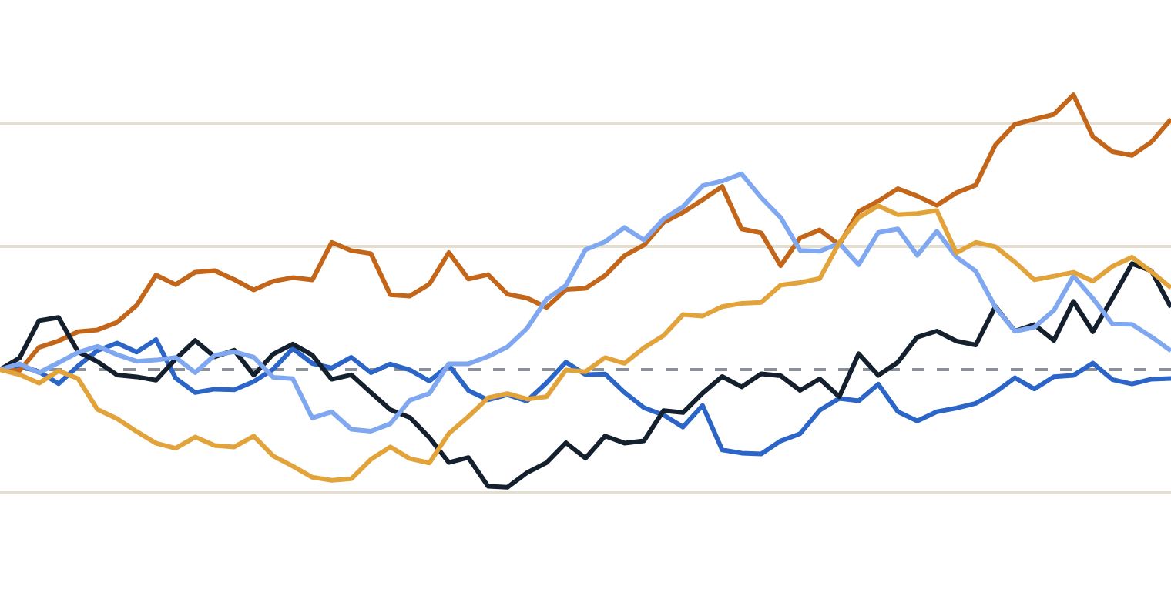
How the stock moves: a steady drift plus random noise
01 · BLACK-SCHOLES, GENTLY · 2 OF 8
dS/S = μ·dt + σ·dW
140
dt a tiny slice of time. dS/S the percentage price change in that slice.
120
100
μ·dt the steady drift: the expected growth.
80
σ·dW the noise: dW is a random shock with variance dt — countless tiny coin flips. Our lattice’s up/down steps, made infinitely small.
today
6 months
1 year
5 simulated paths · S₀ = 100 · μ = 8% · σ = 20%
Notes:
Black and Scholes model the stock as a random walk in percentages, called geometric Brownian motion. Read the equation as a simulation step: in a tiny time slice dt, the percentage change of the stock equals a deterministic drift mu times dt, plus volatility sigma times a random shock dW. dW is normally distributed with mean zero and variance dt — think of it as the net result of an enormous number of tiny coin flips. That is precisely the lattice's up and down moves with the step size shrunk to zero. The chart shows five simulated one-year paths from the same starting point, same mu and sigma, different random numbers. Every one of them is equally consistent with the model; the option price has to be right for all of them at once.

Slide 33
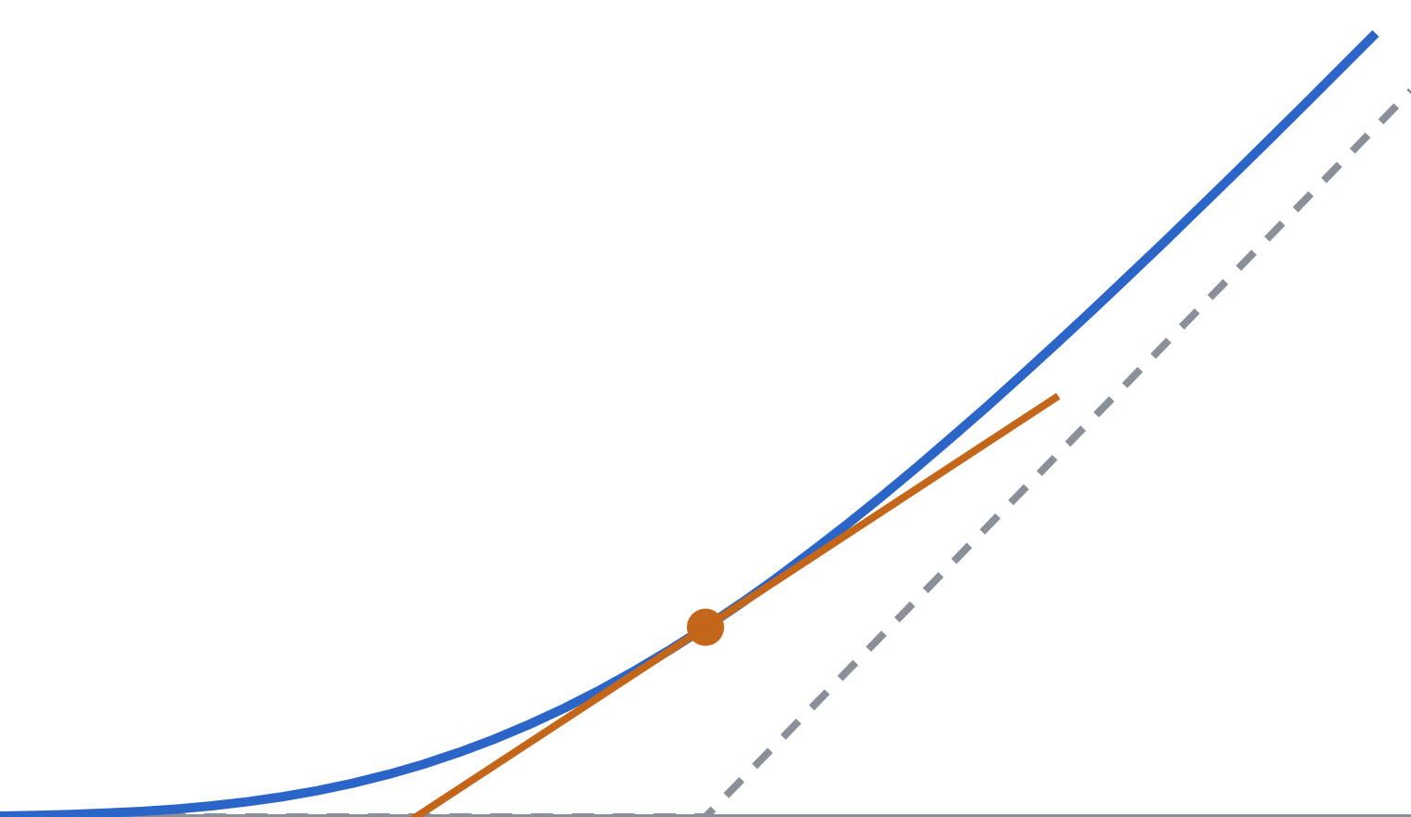
Reading ∂: how V reacts to one input at a time
01 · BLACK-SCHOLES, GENTLY · 3 OF 8
∂V/∂S · delta · slope
━ V(S, t)
━ tangent at S = 100: slope 0.64
╍ payoff at expiry
(V(S+h,t) − V(S−h,t)) / 2h
∂²V/∂S² · gamma · curvature
(V(S+h) − 2V(S) + V(S−h)) / h²
∂V/∂t · theta · time decay
(V(S, t+h) − V(S, t)) / h
60
100
140
∂ = “change one argument, freeze the others”. A unit test with a tiny h computes each one.
stock price S · call value V one year before expiry
Notes:
The curly d, partial derivative, is the second thing that scares people. For developers it's simple: wiggle one argument of the function by a tiny h, keep the others frozen, and measure how much the output changes. The chart is the call value one year before expiry as a function of S — note it's a smooth version of the dashed hockey-stick payoff. Delta, the first derivative in S, is the slope of the tangent: at S equal 100 it's about 0.64, so the option moves 64 cents per euro of stock move. Gamma, the second derivative, is curvature: how quickly the slope itself changes. It's large near the strike, where the curve bends, and close to zero far away. Theta is the change in value as time passes with the price held fixed. The finite-difference formulas on the right are exactly how you'd compute them numerically — and exactly what we did on the lattice's Greeks slide later.

Slide 34
The Black-Scholes equation, one term at a time
01 · BLACK-SCHOLES, GENTLY · 4 OF 8
∂V/∂t + r·S·∂V/∂S + ½σ²S²·∂²V/∂S² = r·V
Time decay
Drift at r
Volatility × curvature
= bank growth
How the value changes as the clock ticks, price frozen (theta).
Stock grows at the risk-free rate r, times the slope (delta). Not μ!
Randomness adds value where V is curved (gamma). No curve, no gain.
Together the hedged option must grow like cash at rate r.
Where it comes from
What pins it down
Hold the option, short Δ = ∂V/∂S shares. The noise cancels; a riskless position must earn r. (The triangle slide, in continuous time.)
V(S, T) = max(S − K, 0)
The payoff at expiry. Solve backward in time from there.
Notes:
Now the equation should be readable. Each term is one of the sensitivities from the previous slide, multiplied by something from the model. Theta, time decay. Plus r S times delta: the stock's drift — but at the risk-free rate r, not at mu, because the stock is held as a hedge. Plus one half sigma squared S squared times gamma: volatility only adds value where the value function is curved. If V were a straight line in S, randomness would average out to nothing. All of this must equal r times V: the hedged option grows like money in the bank. Where does it come from? It's the triangle argument in continuous time: own the option, short delta shares, and over each instant the random parts cancel exactly, so the position is riskless and must earn r. The PDE alone has infinitely many solutions; what selects the call is the final condition — at expiry the value equals the payoff. So, like the lattice, we solve backward from T. Mu has disappeared, just as p did.

Slide 35
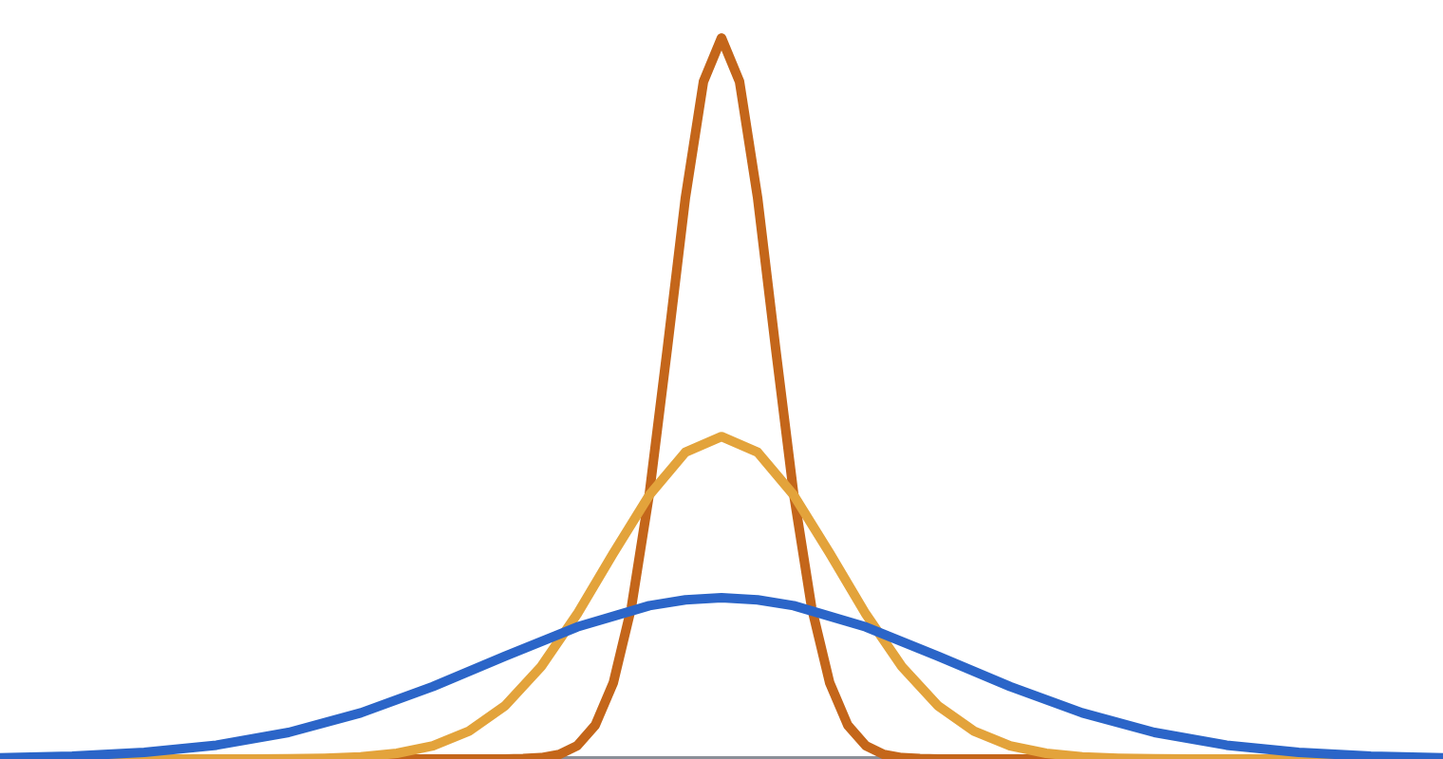

Meanwhile, in physics: the heat equation
01 · BLACK-SCHOLES, GENTLY · 5 OF 8
━ just after the flame
━ a little later
━ much later: wide and low
A metal rod, cold everywhere except one hot spot
∂u/∂τ = κ·∂²u/∂x²
u temperature · x position on the rod · τ time elapsed · κ how fast heat conducts
In words: a point warms up if it is colder than the average of its neighbours. The rate is the curvature — the same ∂² as gamma.
position x along the rod → width grows like √time
Fischer Black was trained in physics (Harvard BA 1959, PhD in applied maths 1964). In their 1973 paper, Black and Scholes showed that a change of variables turns their equation into the heat equation — whose solution was textbook material. Bachelier had already linked price randomness to Fourier’s heat theory in 1900.
Notes:
Now step sideways into physics. Picture a metal rod, cold everywhere except a hot spot in the middle. The heat equation says how temperature u at position x evolves with time tau: its rate of change equals a conductivity kappa times the curvature of the temperature profile. In plain words, a point warms up if it's colder than the average of its neighbours and cools if it's hotter. Over time the spike spreads into a bell curve that gets wider and lower, with width growing like the square root of time — keep that square root in mind. This equation has been solved since Fourier in the early 1800s. Fischer Black's first degree was in physics and his doctorate in applied mathematics. In the 1973 paper, he and Scholes show that with a change of variables their pricing equation becomes exactly this heat equation, so the solution could be taken from standard textbooks. Historically, they first guessed the formula through a finance shortcut and then confirmed it this way. And the connection is older still: Louis Bachelier's 1900 thesis already compared the spreading of price probabilities to Fourier's theory of heat.

Slide 36
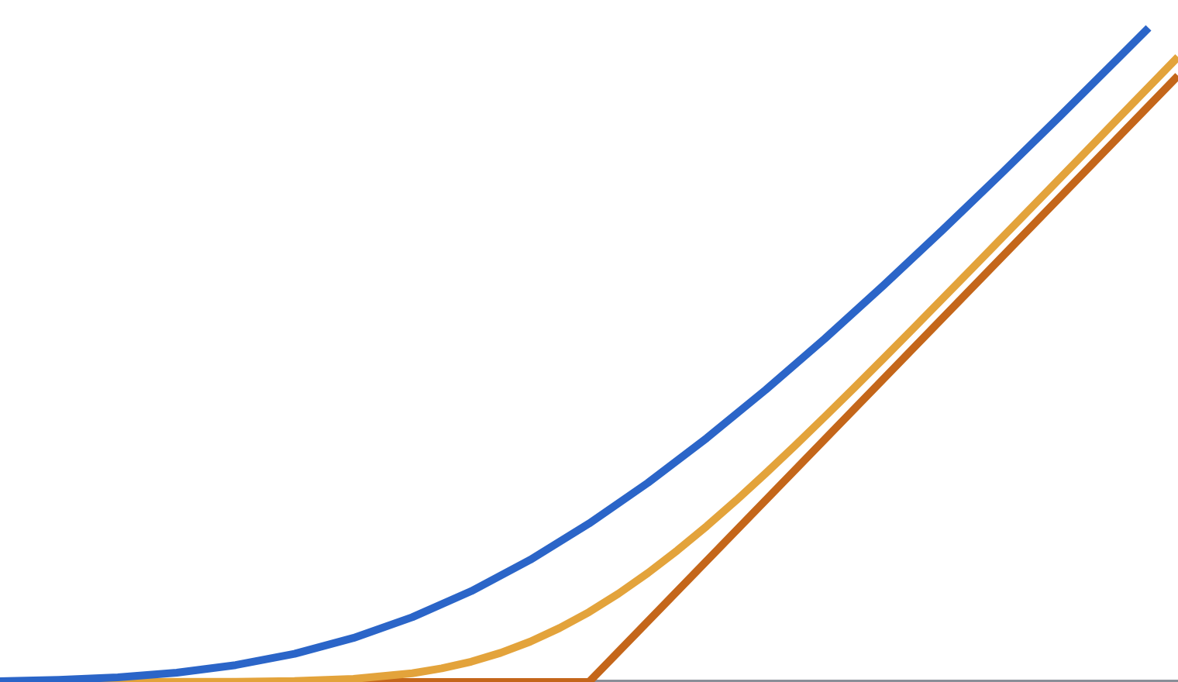
Why heat? Both are random walks
01 · BLACK-SCHOLES, GENTLY · 6 OF 8
Heat in a rod | Option value
Molecules kick at random; spread grows like √time | Trades kick the price; spread grows like σ√T
Initial temperature profile | Payoff at expiry
Diffusion smooths sharp edges | Time to expiry smooths the kink
Conductivity κ | ½σ²
Grid step: average the neighbours | Lattice step: [q·V↑ + (1−q)·V↓] / R
━ at expiry: the payoff
━ 3 months before
━ 1 year before
60
100
140
stock price S · read backward from expiry, the kink “melts”
Notes:
Why on earth would a physics equation describe an option? Because underneath both is the same thing: a random walk. Heat spreads because molecules kick each other randomly; the spread grows like the square root of time. Prices spread because countless trades kick the price randomly; uncertainty grows like sigma times the square root of time. Then map the pieces: the payoff at expiry plays the role of the initial temperature profile. Running the clock backwards from expiry, the sharp kink of the hockey stick gets smoothed out, exactly like a sharp temperature edge on a rod. The chart shows that: the payoff, then the call value three months and one year before expiry. Volatility plays the role of conductivity: more volatility, faster smoothing. And the last row closes the loop with the lattice: one backward step is a weighted average of the two neighbouring nodes — that's literally the simplest numerical scheme for the heat equation. You've already been solving a heat equation by hand.

Slide 37
Refactor: three substitutions reveal the heat equation
01 · BLACK-SCHOLES, GENTLY · 7 OF 8
1
τ = T − t
Count time to expiry. The payoff becomes a starting condition, like the initial temperature.
2
x = ln S + (r − ½σ²)·τ
Use log-price: % moves become plain additive steps. The shift absorbs the drift term.
3
V = e^(−r·τ) · u
Pull out the discounting. The r·V term disappears.
∂u/∂τ = ½σ² · ∂²u/∂x²
The heat equation with κ = ½σ², and the payoff as the initial temperature. Like refactoring until your problem matches a library you already have.
start: u(x, 0) = max(eˣ − K, 0)
Notes:
This is the change of variables that turns Black-Scholes into the heat equation. Think of it as a refactor: rename variables until the code matches a function you already have. Step one: measure time backwards, as time remaining to expiry. Now the payoff at expiry is a starting condition — like the initial temperature profile — and the equation runs forward in tau. Step two: work in the logarithm of the price, shifted by r minus half sigma squared times tau. Logs turn percentage moves into additive steps, which removes the S and S-squared factors, and the shift cancels the first-derivative drift term. Step three: factor out the discount factor e to the minus r tau, which removes the minus r V term. What's left is the pure heat equation with conductivity one half sigma squared, starting from the payoff written in log-price. You don't need to verify the algebra live; the point is that nothing is lost — the finance problem and the physics problem are literally the same equation in different units.

Slide 38
A call pays only when the final price exceeds the strike
01 · BLACK-SCHOLES, GENTLY · 8 OF 8 · PART 1/4
A European call gives you the right to buy a share for a fixed price, the strike K, at expiry. With K = 100, the cash value at expiry is:
Share price at expiry | 80 | 100 | 120 | 140
Call payoff | 0 | 0 | 20 | 40
payoff = max(final_share_price − 100, 0)
Before expiry, we do not know which payoff will occur. Pricing combines the possible payoffs using specific weights, then converts that average to today’s money.
The next slide explains where those pricing weights come from.
Notes:
Optional explanation, no calculus required.
A call is a right, not an obligation. If the share ends at 80, buying it for 100 would make no sense, so the holder lets the right expire and the payoff is zero. At 120, buying for 100 gives value 20. Payoff means the value at expiry before subtracting the premium paid today. European means exercise only at expiry.
The table is an illustrative application of the payoff already used in this deck. It gives no probabilities to the four prices. To find a price today, we need to average over possible payoffs with pricing weights and discount the result. We will explain both operations next.
Assumptions for this section: a non-dividend-paying stock and the idealized Black-Scholes setting already introduced in the deck.

Slide 39
“Risk-neutral” means weights chosen for pricing
01 · BLACK-SCHOLES, GENTLY · 8 OF 8 · PART 2/4
A preview of the one-step example: a share costs 100 today and ends at 90 or 110. Over the same step, a risk-free bank account grows 100 to 102.
The pricing weights
The call with strike 100
40% on 90 and 60% on 110
0.40 × 90 + 0.60 × 110 = 102
Payoffs: 0 if down, 10 if up
0.40 × 0 + 0.60 × 10 = 6
Call price today = 6 / 1.02 = 5.88
The weights make the average share value grow at the bank rate. They need not match real-world odds. A matching share-and-cash portfolio justifies this price under the model’s assumptions.
Notes:
Optional explanation: why these weights and why divide by 1.02?
Let q be the weight on the up outcome. The weighted final stock price must equal what 100 earns in the bank: q × 110 + (1 − q) × 90 = 102. Subtract 90 to get 20q = 12, so q = 0.60. The down weight is 0.40. The word risk-neutral names this pricing convention. It does not say investors feel no risk, and 60% is not a forecast of the actual up probability.
A future payment of 6 has present value 6/1.02 because depositing that amount today grows to 6. Thus the call price is 5.8823529, rounded to 5.88.
Why can pricing ignore actual odds in this idealized model? Buy half a share for 50 and borrow 45/1.02 = 44.117647. The initial net cost is 5.882353. If the share rises, half a share is worth 55 and repaying 45 leaves 10. If it falls, half a share is worth 45 and repaying 45 leaves zero. This portfolio copies the call in every possible outcome. Two investments with identical future payments must have the same price, or a trader can buy the cheaper and sell the dearer for a risk-free gain. That is no-arbitrage.
The weighted-average calculation is an algebraic shortcut for this replication argument. The later lattice section walks through it fully. This two-outcome example differs from the continuous one-year Black-Scholes example, so 5.88 and 10.4506 answer different setups.
Sources within the original deck: slides 39–44, including speaker notes.

Slide 40
The heat equation performs repeated weighted averages
01 · BLACK-SCHOLES, GENTLY · 8 OF 8 · PART 3/4
Slide 37 changed the coordinates to log-price and removed discounting. In those coordinates, solving the heat equation means averaging nearby payoff values.
One illustrative averaging step, before discounting
Nearby payoff entry | Left | Centre | Right
Value | 0 | 0 | 10
Weight | 25% | 50% | 25%
New centre value = 0.25 × 0 + 0.50 × 0 + 0.25 × 10 = 2.50
Repeat with many tiny steps: the averaging weights approach a bell curve. Its spread is σ√T in log-price coordinates. More time or volatility spreads the weights farther.
Notes:
Optional explanation: what the bell curve actually does.
Imagine an array. Each index represents an equally spaced log-price. Each array entry holds the payoff at that position, rather than a probability. Start with the call payoff max(exp(x) − K, 0), as on slide 36.
For a simple numerical example, copy the array, then set each new entry to 0.25 times its left neighbour plus 0.50 times itself plus 0.25 times its right neighbour. Always read from the old array so updates do not depend on loop order. The displayed entries 0, 0, 10 are illustrative. The new centre becomes 2.50 even though its old payoff was zero, because the neighbouring positive payoff contributes.
This is a finite-difference approximation to the heat equation for a suitable time-step/grid-spacing ratio. It is not an exact three-point Black-Scholes calculation, and 2.50 is not the option price for the later one-year example. Repeated steps give more and more distant entries a contribution. In the continuous limit, Gaussian weights describe those contributions.
The heat equation says the rate of change is proportional to curvature. A discrete curvature is left − 2×centre + right. Updating centre by one quarter of that difference gives exactly the 25%, 50%, 25% averaging step shown. This is why local averaging solves the heat equation.
In u_tau = (sigma squared / 2) u_xx, the Gaussian standard deviation after time T is sigma times square root of T. Sigma is annual volatility and T is years. At sigma=0.20 and T=1, the log-coordinate spread is 0.20. At T=0.25 it is 0.10. Four times the time doubles the spread. It is a width in log-price coordinates, not a cash amount or a hard boundary.
The Gaussian describes the weighting kernel in transformed coordinates. The stock price itself is lognormal in Black-Scholes. Undo the coordinate shift and discount to recover today’s option value. The formula on the next slide evaluates this continuous weighted average exactly for a European call.
Sources within the original deck: slides 34–37 and their notes.

Slide 41
Black-Scholes calculates the whole average at once
01 · BLACK-SCHOLES, GENTLY · 8 OF 8 · PART 4/4
For a European call on a stock with no dividends:
C = S × N(d₁) − K × exp(−rT) × N(d₂)
S = share price now K = strike r = annual risk-free rate
T = years to expiry σ = annual volatility C = call price today
N(z) adds up standard-normal weights below z. For example, N(0) = 50%. In code: norm.cdf(z).
N(d₂) gives the pricing probability of finishing above K. N(d₁) also accounts for higher share values in those outcomes.
S = K = 100, r = 5%, σ = 20%, T = 1
d₁ = 0.35, d₂ = 0.15, N(d₁) ≈ 0.6368, N(d₂) ≈ 0.5596
Today’s value received 63.6831 − strike payment 53.2325 = 10.4506
Notes:
Optional explanation: the formula, step by step.
Inputs: S is the stock price now. K is the fixed exercise price. T is time remaining in years. r is the continuously compounded annual risk-free rate. Sigma is annual volatility. This version assumes no dividends and exercise only at expiry, with constant r and sigma and the other idealized Black-Scholes assumptions.
Compute d1 = [ln(S/K) + (r + sigma*sigma/2)*T] / (sigma*sqrt(T)). Then d2 = d1 − sigma*sqrt(T). ln is the natural logarithm, sqrt is square root and exp is the exponential function. At T=0 use the payoff directly instead of dividing by zero. Zero volatility also needs separate handling.
N(z), or scipy.stats.norm.cdf(z), gives the fraction of a standard normal distribution below z. Standard normal means centre zero and standard deviation one. Thus N(0)=0.5. We use it as a library function for adding continuous bell-curve weights.
For the example, ln(100/100)=0. The numerator of d1 is (0.05 + 0.20 squared/2) × 1 = 0.07. The denominator is 0.20, so d1=0.35 and d2=0.15. N(d1)=0.63683065 and N(d2)=0.55961769. The discounted strike is 100 × exp(−0.05)=95.12294245. Multiply to get 63.683065 and 53.232482, whose difference is 10.450584, or 10.4506 rounded.
Why are there two N terms? When the final price exceeds K, the call delivers the share and requires paying K. Otherwise both legs contribute zero. Average the value of the share delivered, average the fixed strike payment, discount both, then subtract. The fixed payment uses only the total pricing weight of exercise outcomes, N(d2). The share leg gives larger contributions to outcomes with larger share prices. Evaluating that price-weighted average produces S × N(d1). Under the same risk-neutral measure N(d1) is not simply another exercise probability.
Optional mathematical identity: C = exp(−rT) × E_Q[(S_T − K) × 1(S_T > K)]. Splitting the difference gives the share leg and strike leg. Under Q, log(S_T) has mean log(S)+(r−sigma squared/2)T and standard deviation sigma*sqrt(T). Standardizing the exercise threshold gives N(d2). Weighting the Gaussian density by S_T shifts its standardized threshold by sigma*sqrt(T), producing d1. This is the integral behind the heat-equation solution.
You can skip this derivation in a live presentation. The essential algorithm is to weight possible payoffs, add them, and discount. The next slide continues with the lattice, which computes the same idea through discrete steps.
Sources within the original deck: slides 36–37 and notes. Worked figures calculated from the original slide 37 inputs.

Slide 42


Why a lattice? Because it is the same idea, made discrete
01 · THE PRICING PROBLEM
Discretise
Dynamic programming
Flexible
Chop [0, T] into n steps of Δt. In each step the price can only go up by a factor u or down by a factor d.
A node’s value depends only on its two children. Fill a triangle backward: O(n²) time, O(n) memory.
Change the rule at a node to handle early exercise, barriers or dividends — no new formula needed.
And as n → ∞, the lattice price converges to the Black-Scholes-Merton price
Notes:
For a developer audience this is the selling point. The lattice turns a PDE into a dynamic-programming table that you fill from the leaves to the root. It's visual: every number lives on a node you can point at. It's general: American options, which have no closed-form price, are a one-line change. And it's honest: as you refine the grid, it converges to Black-Scholes, so you lose nothing by starting here.

Slide 43
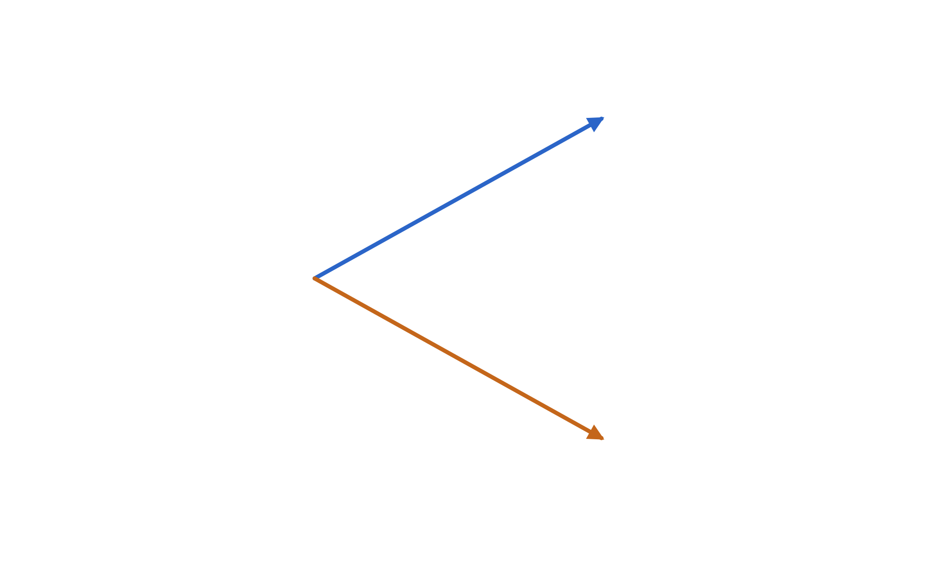
The smallest possible world: one step, two states
02 · ONE STEP
Stock today S₀ = 100. After one step it is either
t = 0
t = Δt
u·S₀ = 110 prob p
d·S₀ = 90 prob 1 − p
uS₀ = 110
call C↑
= 10
p
Cash grows by R = e^(rΔt) = 1.02 per step, risk-free.
S₀ = 100
call C₀
= ?
A call with K = 100 pays 10 or 0. What is it worth now?
1 − p
dS₀ = 90
call C↓
= 0
Notes:
This is the entire model, in miniature. One stock, one step, two possible outcomes. Up by 10% with some real-world probability p, down by 10% with probability one minus p. There is also a bank account that turns 1 into 1.02 over the step, guaranteed. The call with strike 100 pays 10 in the up state and nothing in the down state. Blue always means up and orange always means down from here on. Ask the room: what would you pay for this? Most people reach for p.

Slide 44
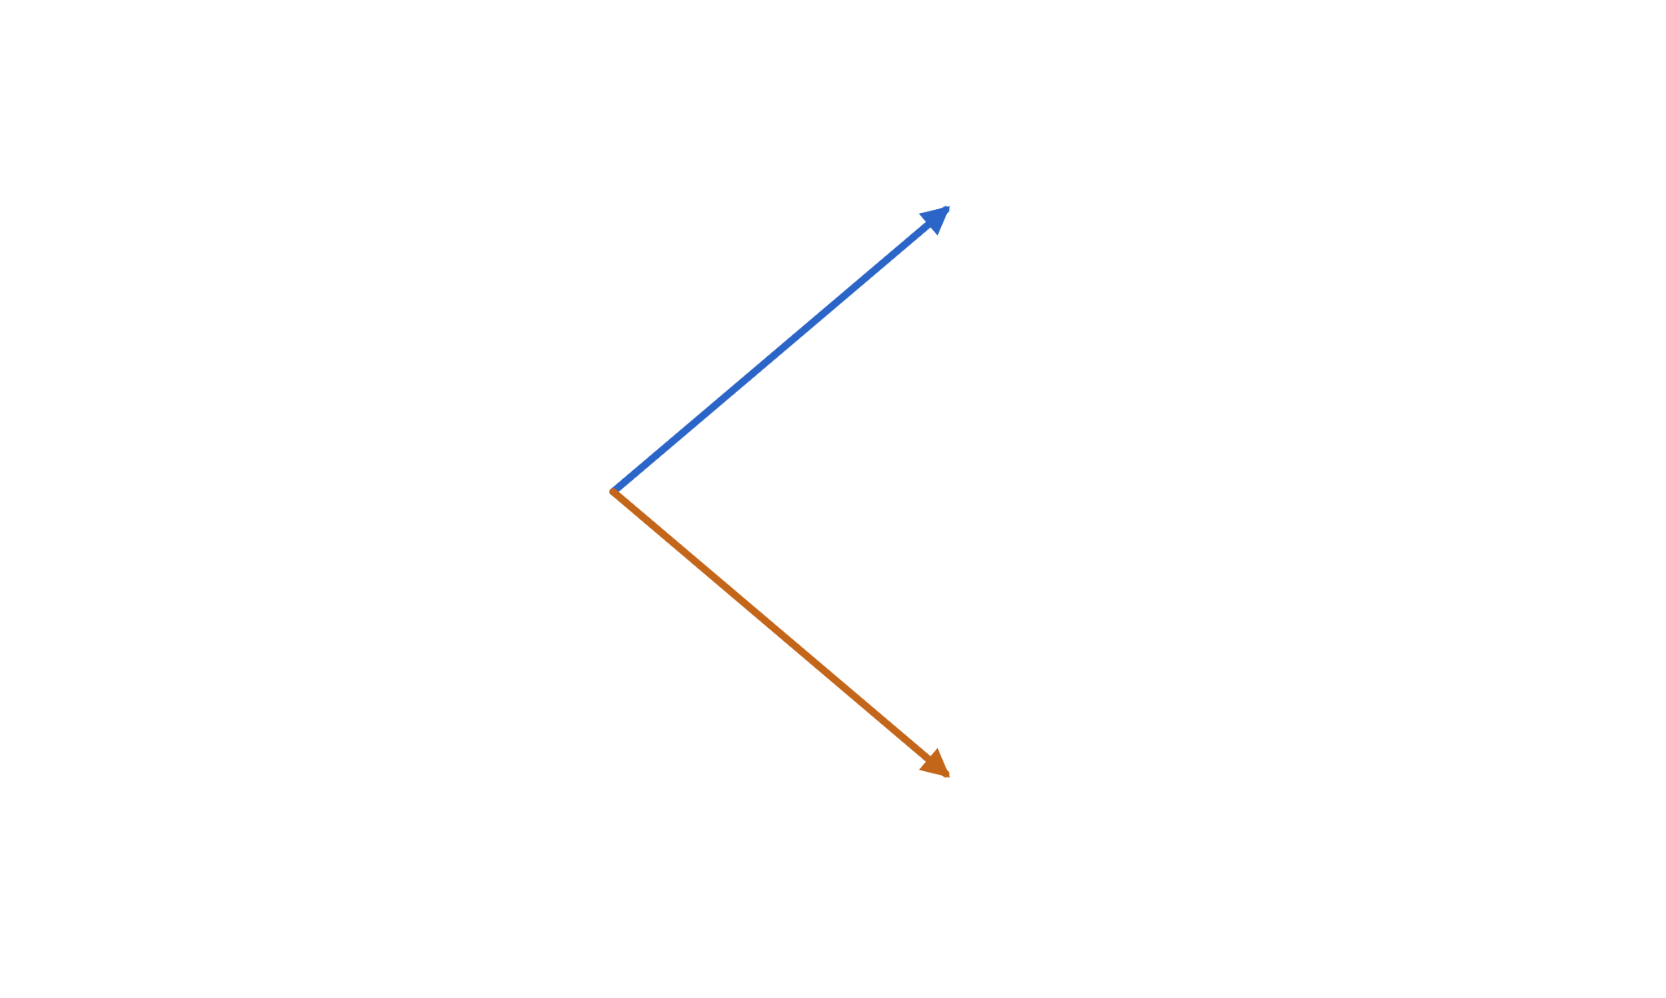
Build a clone: Δ shares plus B in cash
02 · ONE STEP
Two unknowns, Δ and B. Two states, so two equations — one per branch.
Δ·110 + 1.02·B
must pay
C↑ = 10
Δ = (C↑ − C↓)/(S↑ − S↓)
B = (C↓ − Δ·S↓) / R
Δ·100 + B
costs this today
≡ C₀
Δ is the slope of the option payoff across the two states: the hedge ratio.
Δ·90 + 1.02·B
must pay
C↓ = 0
Notes:
Now the trick. Instead of guessing the option's value, build a portfolio that behaves identically. Hold delta shares and B in the bank. In the up state the shares are worth delta times 110 and the cash has grown to 1.02 B. In the down state, delta times 90 plus the same 1.02 B. Force each of those to equal the option payoff in that state. Two linear equations, two unknowns — a developer can solve this in their head. Delta is simply rise over run of the payoff between the two states. Note: no p anywhere in either equation.

Slide 45
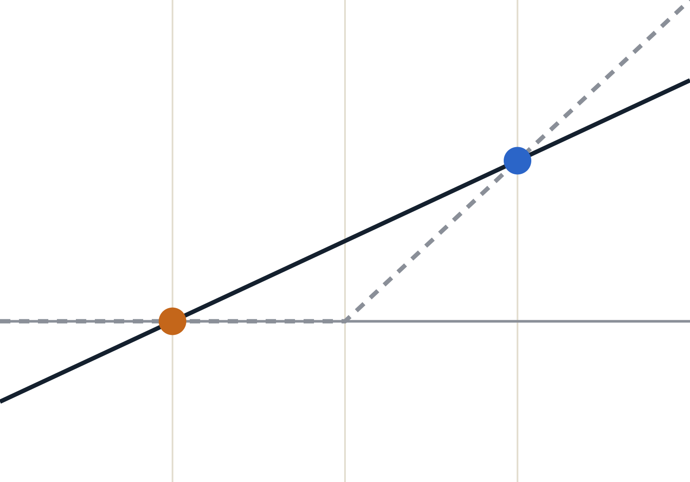
Why a clone exists: two points define a line
02 · ONE STEP · WHY THE CLONE EXISTS
Plot value at the end of the step against the stock price S.
━ clone: 0.5·S − 45
╍ real call payoff max(S − 100, 0)
Shares give a value proportional to S: the slope. Cash gives the same amount whatever S does: the level.
up (110, 10)
clone(S) = Δ·S + R·B
The option only has to match at two points. Exactly one line passes through both:
down (90, 0)
slope Δ = 10/20 = 0.5
level R·B = −45 → B = −44.12
80
90
100
110
120
Notes:
This slide answers the obvious question: why should a mix of shares and cash be able to copy an option at all? Draw the end-of-step value against the stock price. Holding delta shares gives a value that rises in proportion to S — a slope. Holding cash gives the same amount whatever happens — a constant level. So any shares-plus-cash portfolio is a straight line. The option's payoff is a hockey stick, which is not a line. But in our one-step world the stock can only end up at 90 or 110, so the option only needs to be matched at two points — and through any two points there is exactly one line. Rise over run gives the slope, 0.5 shares. The line's level at the end is minus 45, so we owe 45 at the end, meaning we borrow 45 over 1.02, which is 44.12, today. For developers: it's solving a 2-by-2 linear system, or a regression with zero residual. And it tells you why the binomial step is the building block: with three possible outcomes a straight line couldn't hit three points, and you'd need another traded instrument.

Slide 46
Solve it: the clone costs 5.88, so the option does too
02 · ONE STEP
SHARES
CASH (BORROWED)
OPTION PRICE
0.50
−44.12
5.88
Δ = (10 − 0)/(110 − 90)
B = (0 − 0.5·90)/1.02
C₀ = 0.5·100 − 44.12
Check | Shares | Repay loan | Portfolio
Up (S = 110) | 0.5 × 110 = 55.00 | −44.12 × 1.02 = −45 | 10 = C↑ ✓
Down (S = 90) | 0.5 × 90 = 45.00 | −44.12 × 1.02 = −45 | 0 = C↓ ✓
Notes:
Plug in the numbers. Delta is 10 over 20, so half a share. To kill the payoff in the down state we must owe exactly 45 at the end, which means borrowing 45 over 1.02, about 44.12, today. Total cost of the clone: 50 for the half share, minus 44.12 borrowed, equals 5.88. The table verifies the clone pays exactly 10 or 0. If the option traded at 6.50 you would sell it, buy the clone for 5.88, and pocket 0.62 with zero risk. If it traded at 5.00 you'd do the reverse. Only 5.88 survives.

Slide 47
If the price is wrong, a money machine appears
02 · ONE STEP · NO-ARBITRAGE
Suppose someone quotes the option at 6.50 instead of 5.88. Sell it, and buy the clone:
Trade | Today | Up: S = 110 | Down: S = 90
Sell 1 option | +6.50 | −10.00 | 0.00
Buy 0.5 share | −50.00 | +55.00 | +45.00
Borrow cash | +44.12 | −45.00 | −45.00
Net | +0.62 | 0.00 | 0.00
Profit now, no risk later
Too cheap? Run it in reverse
Whatever the stock does, the clone pays off the option exactly. The 0.62 is free.
At 5.00: buy the option, short the clone, pocket 0.88. Traders’ code does this until only 5.88 is left.
Notes:
Now make "no-arbitrage" concrete with a trade ledger, like a unit test that must pass in every state. Suppose a dealer quotes the option at 6.50. You sell the option at 6.50, buy half a share for 50, and borrow 44.12 to fund the difference. You're left with 62 cents in your pocket today. One step later, in the up state you owe the option holder 10, your half share is worth 55, and you repay 45 on the loan: net zero. In the down state the option is worthless, the shares are worth 45, and you repay 45: net zero again. Money today, zero in every future state, no risk: an arbitrage. If the option were quoted too low, say 5.00, you reverse every line. Algorithmic traders scan for exactly these gaps; their buying and selling pushes the price until the gap closes at 5.88. That's what we mean by "the" option price.

Slide 48
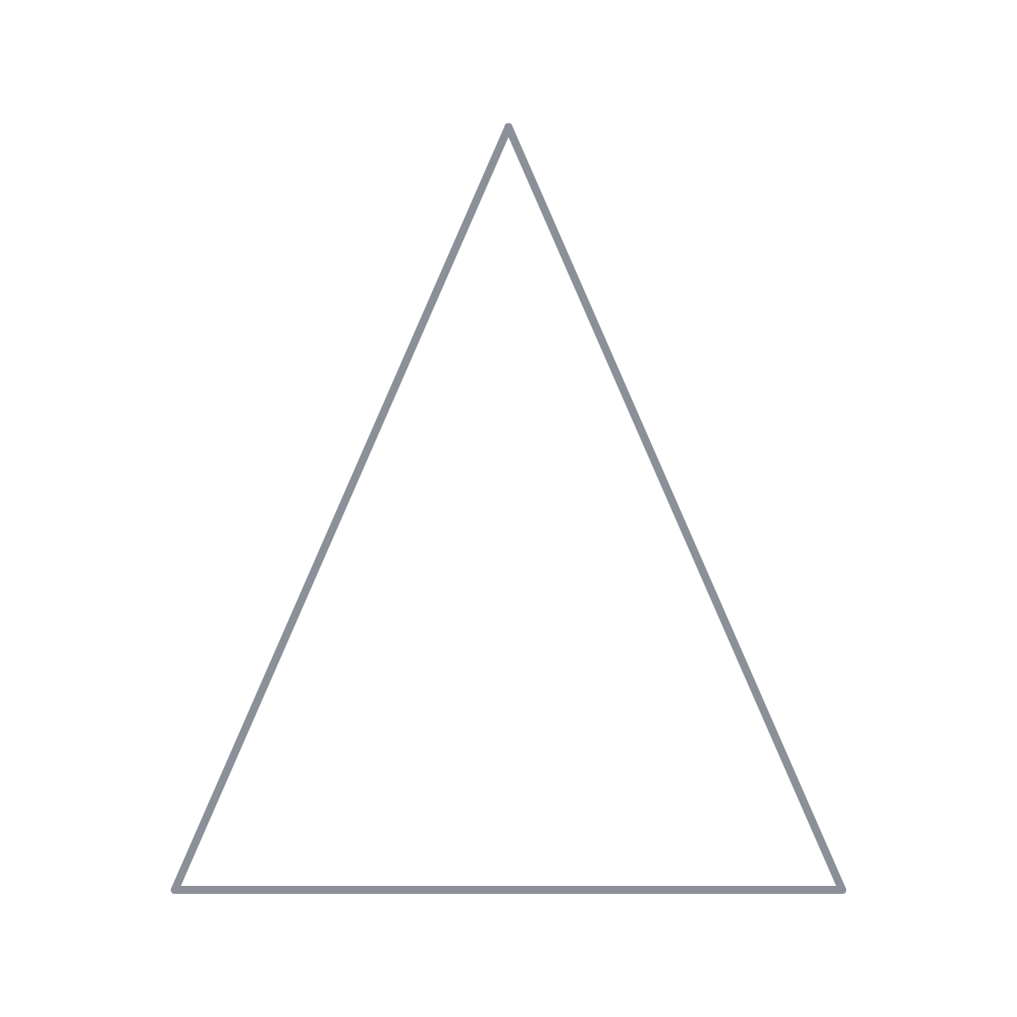
Share, option, cash: any two build the third
02 · ONE STEP · THE EQUIVALENCE
Option
Option = 0.5 share − 44.12 cash
Replicate. Up: 55 − 45 = 10 ✓ Down: 45 − 45 = 0 ✓ Cost 5.88.
Cash = 0.5 share − 1 option
Hedge. Pays 45 in both states: riskless, so it must be worth 45/1.02 = 44.12. Hence option = 50 − 44.12 = 5.88.
any two →
the third
Share = 2 options + 88.24 cash
Synthetic share. Up: 20 + 90 = 110 ✓ Down: 0 + 90 = 90 ✓ Cost 2·5.88 + 88.24 = 100 ✓
Share
Cash
The key move: a delta-hedged option is a bond. A bond earns the risk-free rate. That alone fixes the price.
Notes:
This is the equivalence behind the "rabbit out of the hat". In a one-step, two-state world we have three assets — the share, the option and risk-free cash — but only two independent outcomes. So the three are linearly dependent: any two can be combined to reproduce the third. Read the cards as three rearrangements of one equation. First, option equals half a share minus 44.12 of cash: the replication we just built. Second, rearrange: half a share minus one option pays 45 whatever happens. Something that pays the same in every state is just a bond, and a bond must be worth its payment discounted at the risk-free rate, 44.12. That's where the price comes from: hedge the option with delta shares and the randomness cancels, leaving a riskless position that must earn the bank rate. Third, rearrange again: two options plus 88.24 in cash behave exactly like one share. Nothing here needs probabilities — only the payoffs in each state and the price of cash. "Free money" in the earlier slide means risk-free money: the bank account. And if any of the three is mispriced relative to the other two, the money machine from the previous slide switches on.

Slide 49
Rearrange the algebra and a new probability appears
02 · ONE STEP
C₀ = Δ·S₀ + B = [ (R − d)/(u − d)·C↑ + (u − R)/(u − d)·C↓ ] / R
q = (R − d) / (u − d)
Example
q = 0.12 / 0.20 = 0.60
C₀ = 0.6·10 / 1.02 = 5.88 ✓
C₀ = [ q·C↑ + (1 − q)·C↓ ] / R
The real-world probability p appears nowhere.
Notes:
This is the slide to pause on. Substitute the formulas for delta and B into delta S plus B and collect terms. The weights in front of C-up and C-down add up to one, and they're both positive as long as d is less than R is less than u. So they behave like probabilities. Call the up-weight q. The price is then a discounted expected payoff — exactly the form people guessed on the naive slide — but with q instead of p, and discounted at the risk-free rate instead of some mystery rate. q is pinned down by u, d and R alone. Your opinion about p, however strong, does not change the price.

Slide 50
Two worlds: p forecasts, q prices
02 · ONE STEP
 | Real world, p = 0.70 | Risk-neutral, q = 0.60
Where it comes from | Opinion, history, research | (R − d)/(u − d): market data
Expected stock growth / step | 0.7·1.1 + 0.3·0.9 = 1.04 | 0.6·1.1 + 0.4·0.9 = 1.02 = R
Discounted E[call payoff] | 0.7·10 / 1.02 = 6.86 | 0.6·10 / 1.02 = 5.88
Is that a tradeable price? | No: sell at 6.86, buy clone, keep 0.98 | Yes: the only arbitrage-free price
Intuition
Sanity condition
Price as if every asset grows at the risk-free rate. The hedge removes risk, so risk preferences can’t matter.
d < R < u ⇔ 0 < q < 1. Otherwise the stock or the bank dominates, an arbitrage.
Notes:
Make the distinction explicit. p is a forecast and belongs to the real world. q is a pricing device and belongs to an imaginary, risk-neutral world in which the stock is expected to grow at exactly the bank rate. Under q the option's price is a plain discounted expectation. Under p, the same calculation gives 6.86 — and anyone quoting 6.86 can be arbitraged by selling them the option and holding the clone. Where did the investor's view go? It's already inside today's stock price. The condition d less than R less than u is the no-arbitrage requirement: if the bank beat even the up-move, nobody would hold the stock.

Slide 51
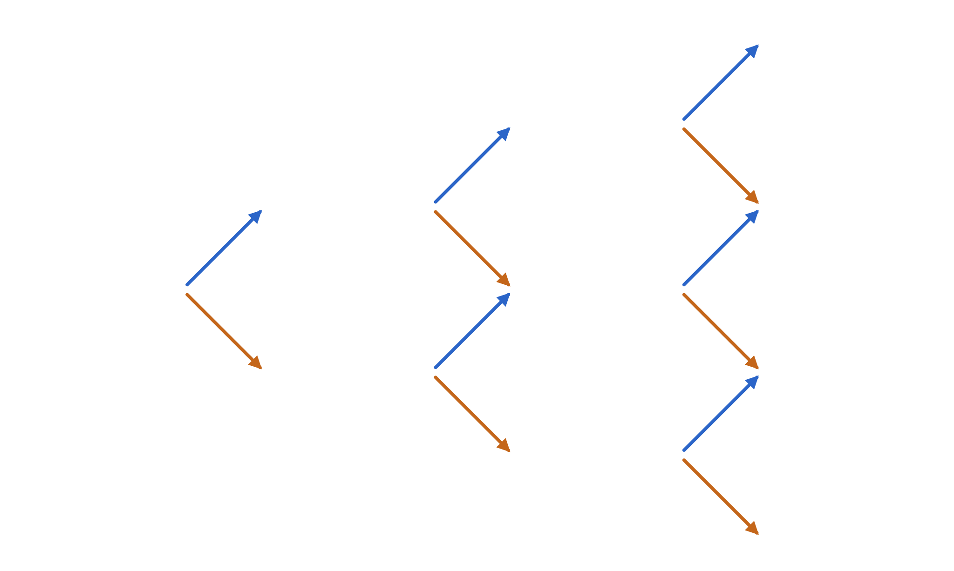
Stack the step: a recombining lattice
03 · THE LATTICE
Repeat the one-step move n times. Because u·d = d·u, paths merge: up-then-down lands where down-then-up does.
t = 0
t = 1
t = 2
t = 3 = T
S₀u³
1 path
S₀u²
1 path
node (i, j):
S = S₀·uʲ·dⁱ⁻ʲ
S₀u
1 path
S₀u²d
3 paths
S₀
1 path
S₀ud
2 paths
i = step, j = number of up-moves. n steps give n + 1 leaves, not 2ⁿ paths. With n = 100: 101 nodes instead of ~10³⁰ paths.
S₀d
1 path
S₀ud²
3 paths
S₀d²
1 path
S₀d³
1 path
Notes:
Now glue one-step trees together. From every node we again go up by u or down by d. The crucial property is recombination: up-then-down and down-then-up land on the same price, because multiplication commutes. So the tree is really a triangle — a lattice. Each node is addressed by two integers: the step i and the number of up-moves j. The highlighted nodes show where several paths merge; the path counts 1, 2, 1 and 1, 3, 3, 1 are Pascal's triangle, which will matter in two slides. For a developer: this is the difference between exponential and quadratic complexity.

Slide 52
Forward pass ①: propagate prices
03 · THE LATTICE · FORWARD PASS ①
Start at the root and push prices to the right. Each node feeds two children:
t = 0
t = 1
t = 2
t = 3 = T
133.10
uuu
121.00
uu
S↑ = S · 1.10
S↓ = S · 0.90
110.00
u
108.90
uud
Purely mechanical — no probabilities yet. The leaves span every possible outcome: 72.90 … 133.10.
100.00
root
99.00
ud
90.00
d
89.10
udd
81.00
dd
72.90
ddd
Notes:
Our running example now has three steps. The first thing that flows forward, left to right, is the stock price itself. It's the simplest pass: multiply by 1.1 going up, by 0.9 going down. The middle node at t=2 is 99, not 100, because 1.1 times 0.9 is 0.99 — with the calibrated tree later we'll pick d equal to one over u so the middle returns exactly to the start. Notice the arrows point right: information is flowing forward in time. There are three things we can propagate forward — prices, probabilities and state prices — and we'll do all three.

Slide 53
Forward pass ②: propagate probabilities
03 · THE LATTICE · FORWARD PASS ②
Probability mass flows right: a node sends a share p up and
1 − p down;
merging paths add up. The result is the binomial distribution — Pascal’s triangle × pʲ(1 − p)ⁿ⁻ʲ.
t = 0
t = 1
t = 2
t = 3 = T
133.10
p³
121.00
p²
110.00
p
108.90
3p²(1−p)
S(T) | p = .7 | q = .6
133.10 | 34.3% | 21.6%
108.90 | 44.1% | 43.2%
89.10 | 18.9% | 28.8%
72.90 | 2.7% | 6.4%
100.00
1
99.00
2p(1−p)
90.00
1−p
89.10
3p(1−p)²
81.00
(1−p)²
72.90
(1−p)³
Notes:
The second forward pass carries probability mass. Think of pouring one litre of water in at the root: at every node a fraction p flows up and 1 minus p flows down, and where paths merge the water adds. The coefficients 1, 2, 1 and 1, 3, 3, 1 are exactly the path counts from the previous slide. The table compares two choices: the real-world p of 0.7 and the risk-neutral q of 0.6. The real world puts more weight on the high outcomes — the stock is expected to outperform cash — while the risk-neutral world tilts down so that the expected growth equals the bank rate. In the continuous limit, this forward pass is the Fokker-Planck, or Kolmogorov forward, equation.

Slide 54
Forward pass ③: propagate state prices
03 · THE LATTICE · FORWARD PASS ③
ψ(node) = what you would pay today for $1 delivered only if the stock lands on that node (Arrow-Debreu price).
t = 0
t = 1
t = 2
t = 3 = T
133.10
ψ 0.2035
121.00
ψ 0.3460
ψ(child) = Σ ψ(parent)·w / R
w = q (up) or 1 − q (down)
110.00
ψ 0.5882
108.90
ψ 0.4071
100.00
ψ 1.0000
99.00
ψ 0.4614
Same flow as the probabilities, but with q and a discount per step. The leaves sum to 1/R³ = 0.9423: a sure $1 at T.
90.00
ψ 0.3922
89.10
ψ 0.2714
81.00
ψ 0.1538
72.90
ψ 0.0603
Notes:
The third forward quantity is the most powerful and the least known: state prices, also called Arrow-Debreu prices. A state price answers: what is a ticket worth today that pays one dollar if, and only if, the stock ends up on this node? It's just the risk-neutral probability with one discount factor per step folded in. Walk the first step with the room: 0.6 over 1.02 is 0.588, 0.4 over 1.02 is 0.392. Then the merge at t=2 middle: 0.588 times 0.4 plus 0.392 times 0.6, all over 1.02, gives 0.461. Sanity check: buy every leaf ticket and you are guaranteed $1 at T, so the leaf state prices must add up to the discount factor 1 over R cubed. They do: 0.9423. Once you have the leaf state prices, any European payoff can be priced with a single dot product — we'll come back to that right after the backward pass.

Slide 55
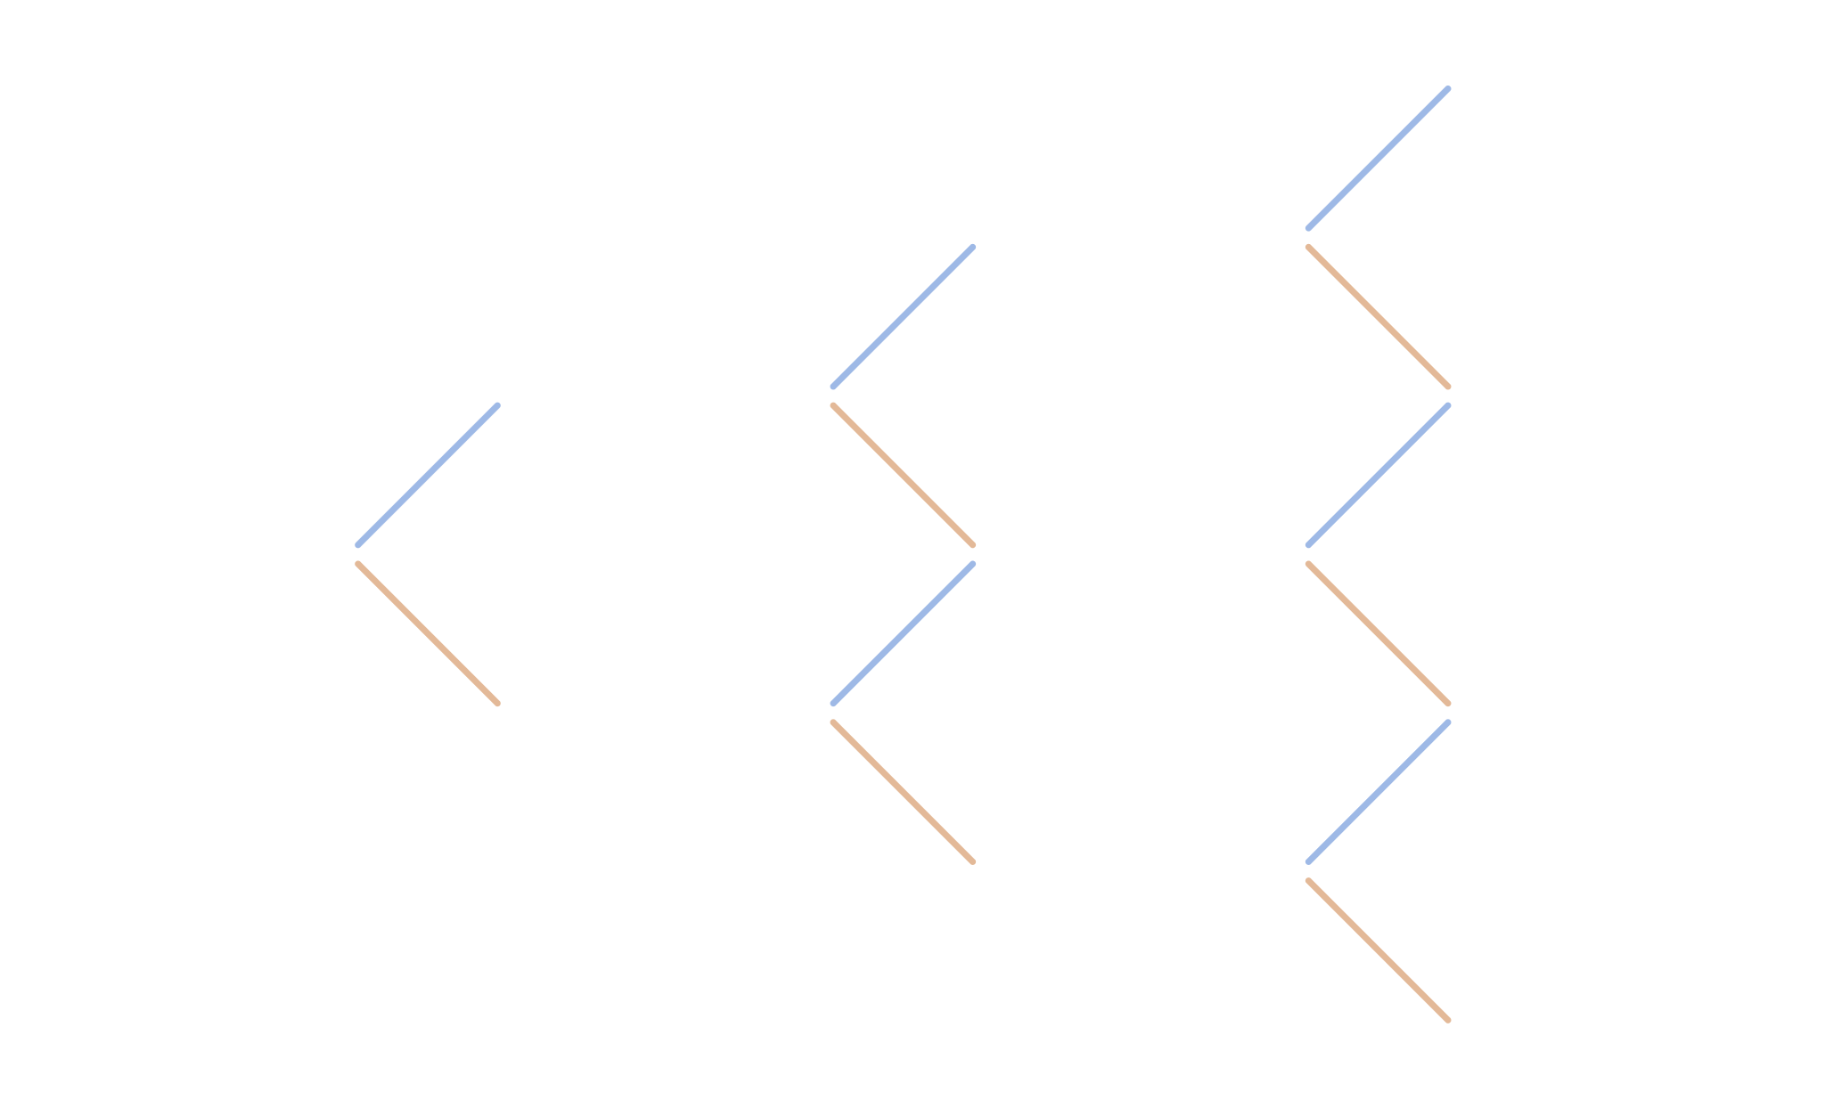
At expiry, the value is simply the payoff
03 · THE LATTICE · TURNING POINT
On the leaves there is no uncertainty left. For a call with K = 100:
t = 0
t = 1
t = 2
t = 3 = T
133.10
C = 33.10
121.00
C = ?
C(T) = max(S − 100, 0)
110.00
C = ?
108.90
C = 8.90
Every earlier node is still a question mark. To fill them in we turn around and walk backward in time.
100.00
C = ?
99.00
C = ?
90.00
C = ?
89.10
C = 0.00
81.00
C = ?
72.90
C = 0.00
Notes:
This is the turning point of the algorithm. The forward pass told us which prices are possible at expiry. At expiry the option is worth exactly its payoff — there's nothing left to be uncertain about. So the right-hand column is known: 33.10, 8.90, zero, zero. Everything to the left is unknown. Note that this is the same structure as the Black-Scholes PDE: we know the solution at the final time T as a boundary condition, and we need the solution at time zero. The arrows are greyed out because we are about to reverse their direction.

Slide 56
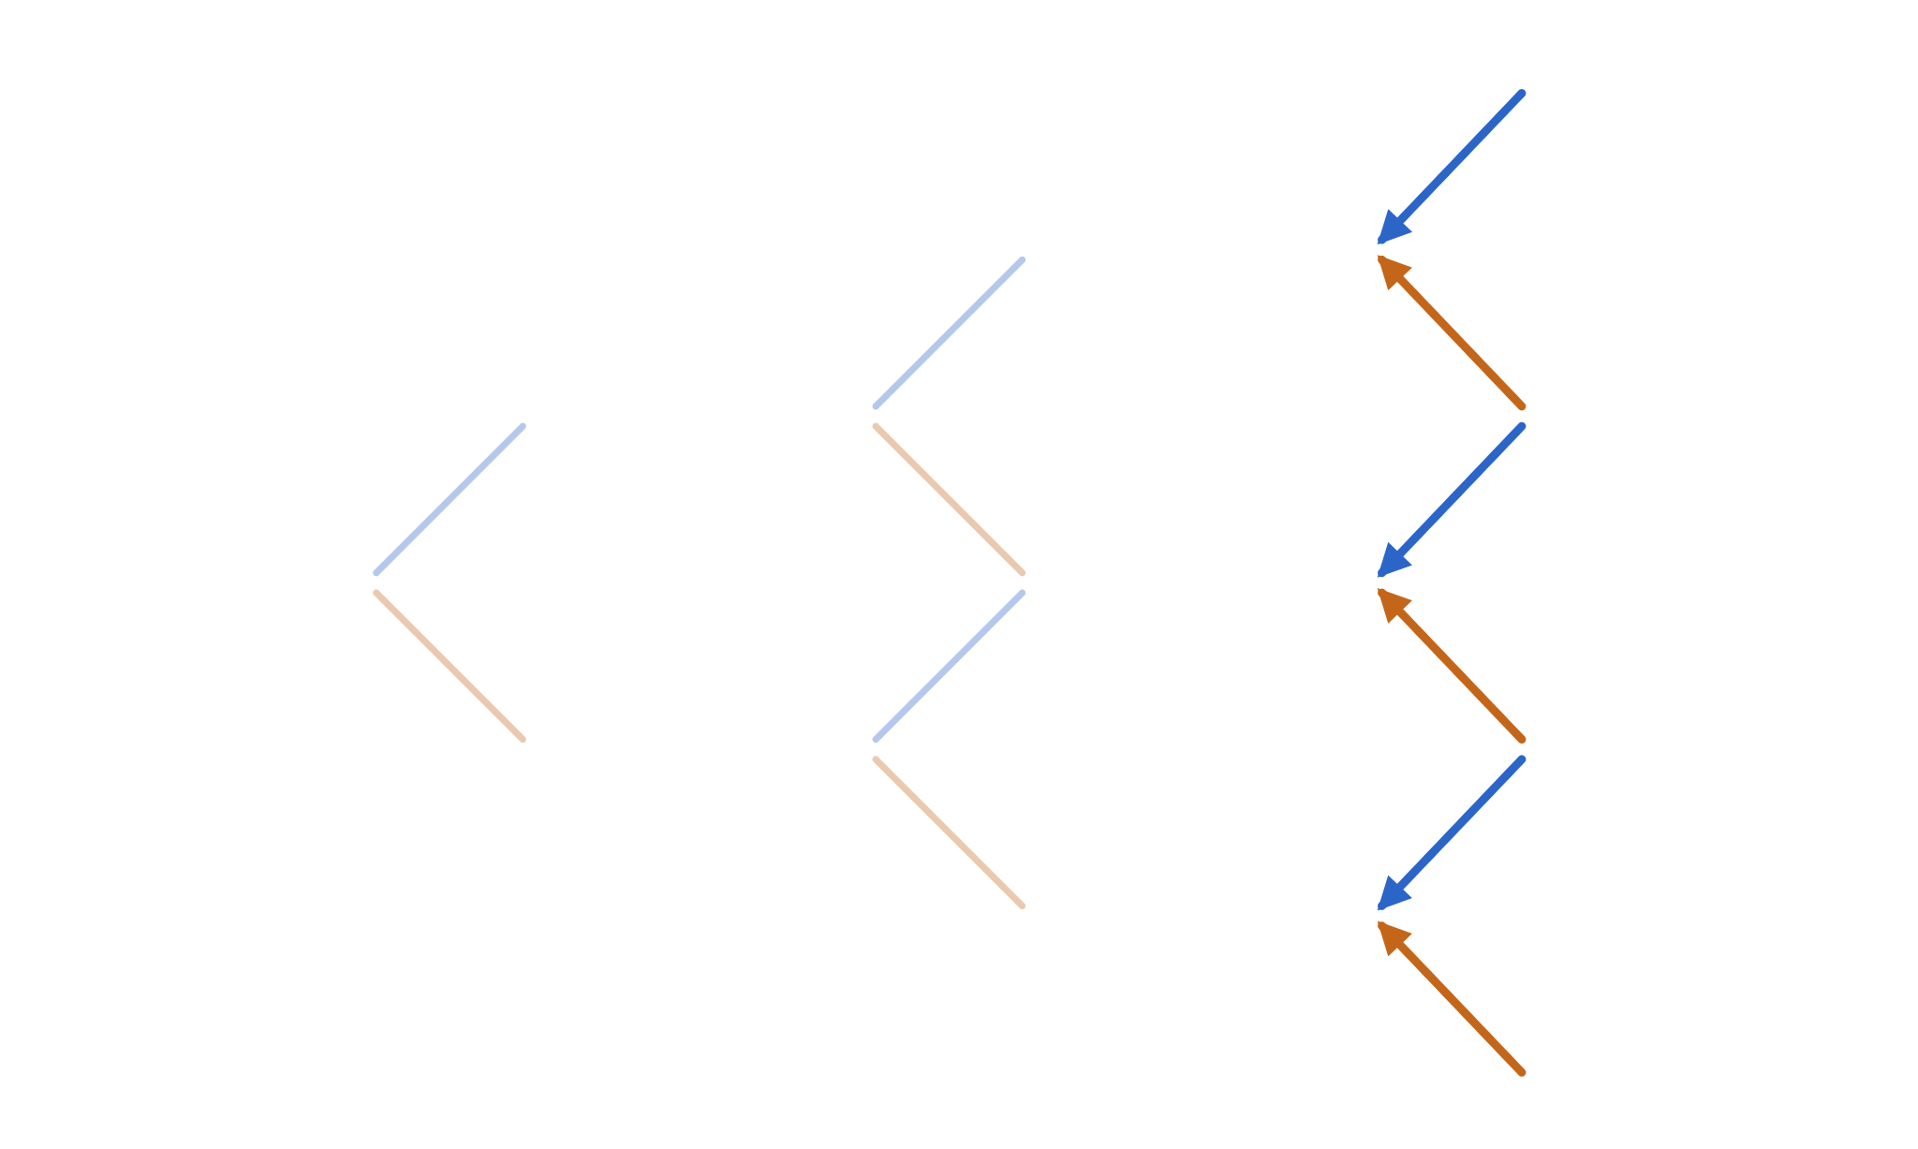
Backward pass: one step at a time
03 · THE LATTICE · BACKWARD PASS
Every node is a one-step problem we already solved. Apply the same rule everywhere:
t = 0
t = 1
t = 2
t = 3 = T
133.10
C = 33.10
121.00
C = 22.96
V = [q·V↑ + (1−q)·V↓] / R
110.00
C = ?
108.90
C = 8.90
100.00
C = ?
99.00
C = 5.24
Top node at t = 2:
90.00
C = ?
89.10
C = 0.00
(0.6·33.10 + 0.4·8.90) / 1.02 = 22.96
81.00
C = 0.00
72.90
C = 0.00
Notes:
Now the arrows point left: information flows backward in time. The key realisation is that every interior node, together with its two children, is exactly the one-step problem we solved earlier. So we apply the same formula — q times the up value plus one minus q times the down value, discounted one step. The highlighted node: 0.6 times 33.10 plus 0.4 times 8.90 is 23.42; divided by 1.02 that's 22.96. The middle node gets 0.6 times 8.90 over 1.02, which is 5.24, and the bottom node is zero because both its children are zero. This is dynamic programming: a node's value depends only on its children, never on how we got there.

Slide 57
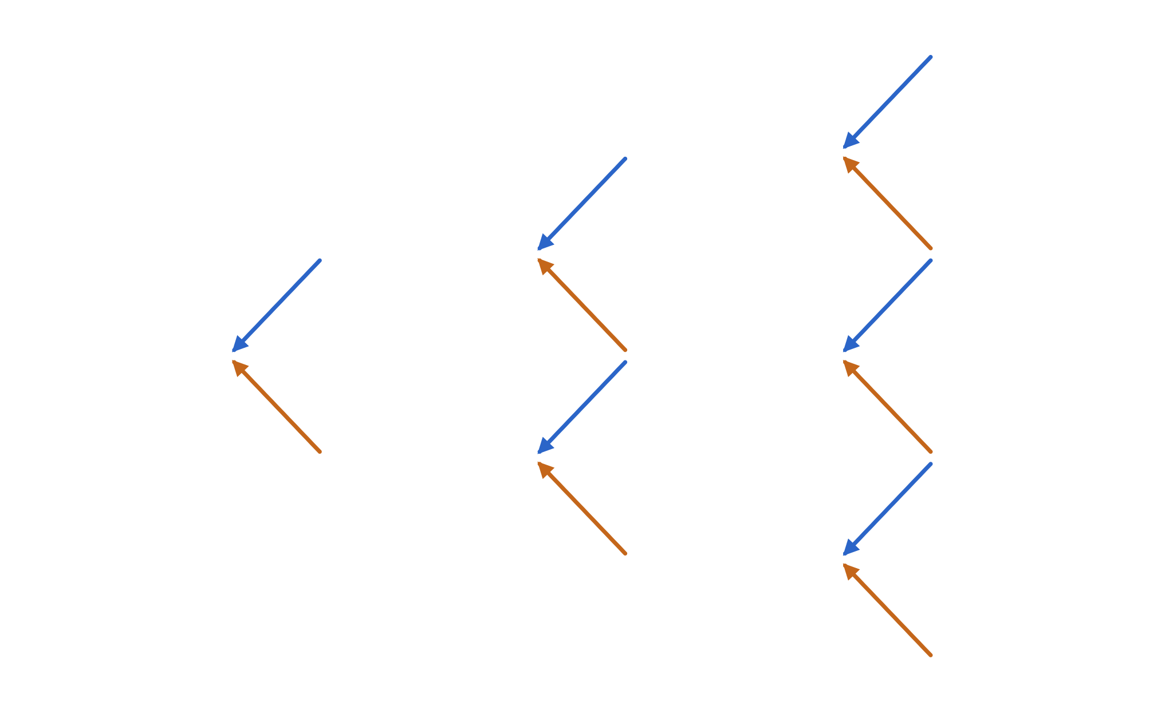
Repeat to the root: the option is worth 10.36
03 · THE LATTICE · BACKWARD PASS
Same rule, column by column, right to left:
t = 0
t = 1
t = 2
t = 3 = T
133.10
C = 33.10
t=1 ↑ (.6·22.96+.4·5.24)/1.02 = 15.56
t=1 ↓ (.6·5.24+.4·0)/1.02 = 3.08
t=0 (.6·15.56+.4·3.08)/1.02 = 10.36
121.00
C = 22.96
110.00
C = 15.56
108.90
C = 8.90
100.00
C = 10.36
99.00
C = 5.24
Ten nodes, nine multiply-adds. Real-world p was never used.
90.00
C = 3.08
89.10
C = 0.00
81.00
C = 0.00
72.90
C = 0.00
Notes:
Keep rolling left. The two t=1 nodes come out at 15.56 and 3.08, and the root at 10.36. That's the price of the three-step call. Point at the whole picture: forward we generated the stage, the possible prices; backward we generated the values. Every one of those nodes also has its own replicating portfolio, which we'll use in a moment for hedging and Greeks. And once more: p equals 0.7 never entered the calculation. If you had used p, you'd get 14.40, and you would be arbitraged.

Slide 58
Two routes through the lattice, one price
03 · THE LATTICE · FORWARD MEETS BACKWARD
Forward → state prices · payoff
Backward ← induction
Leaf S | payoff | ψ | ψ·payoff
133.10 | 33.10 | 0.2035 | 6.737
108.90 | 8.90 | 0.4071 | 3.623
89.10 | 0.00 | 0.2714 | 0.000
72.90 | 0.00 | 0.0603 | 0.000
Σ |  |  | 10.360
Step | Values, top to bottom
t = 3 | 33.10 · 8.90 · 0 · 0
t = 2 | 22.96 · 5.24 · 0
t = 1 | 15.56 · 3.08
t = 0 | C₀ = 10.360
C₀ = R⁻ⁿ · Σⱼ (n choose j) · qʲ(1−q)ⁿ⁻ʲ · payoff(S₀·uʲ·dⁿ⁻ʲ)
Forward sums ψ against payoffs; backward nests the same sum. Same numbers, opposite order of evaluation.
Notes:
This is the slide that ties the forward and backward views together. On the left, use the state prices we propagated forward and take the dot product with the payoffs at the leaves: 6.737 plus 3.623 gives 10.360. On the right, the backward induction we just did gives 10.360 too. They must agree, because both are evaluations of the same sum — the closed-form binomial formula at the bottom. Forward is like computing the distribution first and then integrating the payoff against it; backward is like Horner's rule, nesting the sum. For a single European payoff the forward route is cheap to reuse across many strikes; the backward route is the only one that handles decisions along the way, like early exercise. In continuous time these are the Kolmogorov forward and backward equations — the backward one is the Black-Scholes PDE.

Slide 59
The whole method fits on one screen
03 · THE LATTICE · IN CODE
def price(S0, K, r, sigma, T, n, call=True, american=False):
dt = T / n
u = exp(sigma * sqrt(dt)); d = 1 / u
R = exp(r * dt); q = (R - d) / (u - d)
# forward: prices at the leaves
S = [S0 * u**j * d**(n - j) for j in range(n + 1)]
V = [max(s - K, 0) if call else max(K - s, 0) for s in S]
# backward: roll values to the root
for i in range(n - 1, -1, -1):
for j in range(i + 1):
V[j] = (q * V[j + 1] + (1 - q) * V[j]) / R
if american:
s = S0 * u**j * d**(i - j)
V[j] = max(V[j], (s - K) if call else (K - s))
return V[0]
O(n²) time
n(n+1)/2 node updates
O(n) memory
One array, overwritten in place
n = 1000 →
call 10.4486
BS 10.4506
Notes:
For developers, here is the entire algorithm. It uses the calibrated Cox-Ross-Rubinstein parameters we'll derive in the last section — u is e to the sigma root dt, d is one over u. The forward part is a single list comprehension for the leaf prices and payoffs. The backward part is a double loop that overwrites one array in place: V[j] at level i only needs V[j] and V[j+1] from level i+1, which haven't been overwritten yet because j increases. The American flag adds two lines — we'll see why on the next few slides. With a thousand steps this runs in milliseconds in plain Python and is within two thousandths of the Black-Scholes price.

Slide 60

Every node carries its own hedge
04 · USING THE LATTICE · HEDGING
At each node, hold the one-step clone:
t = 0
t = 1
t = 2
t = 3 = T
C 33.10
payoff
Δ = (V↑ − V↓)/(S↑ − S↓)
B = V − Δ·S
C 22.96
Δ 1.000
Today: 0.624 shares (62.40) and borrow 52.04 → 10.36. Rebalance after each move; the portfolio always equals the node value, with no cash added or removed.
C 15.56
Δ 0.806
C 8.90
payoff
C 10.36
Δ 0.624
C 5.24
Δ 0.449
C 3.08
Δ 0.291
C 0.00
payoff
Δ → 1 deep in the money, Δ → 0 far out of it.
C 0.00
Δ 0.000
C 0.00
payoff
Notes:
The price is only half the story. Each interior node is a one-step problem, and each one-step problem came with a replicating portfolio. So the lattice is also a hedging plan: at the root hold 0.624 shares and borrow 52.04. If the stock goes up, rebalance to 0.806 shares; if down, to 0.291. The plan is self-financing: the value of the old portfolio at the new node always exactly equals the cost of the new one, so a bank selling this option at 10.36 can hedge it perfectly in this model and end up flat in every path. Notice how delta tracks moneyness — close to one when the option is sure to be exercised, zero when it can't be.

Slide 61

The Greeks: a risk dashboard for one option
04 · USING THE LATTICE · GREEKS 1 OF 7
A price is one number. A trader also needs to know how that number will move. Each Greek = the change in V when one input moves, with all others frozen.
Greek | Sensitivity to | The question it answers | Our call*
Δ Delta | stock price S | Stock +1 → option +how much? | +0.64
Γ Gamma | delta, as S moves | How fast does my hedge go stale? | +0.019
Θ Theta | time passing | What does one more day cost me? | −0.018/day
ν Vega | volatility σ | Market gets jumpier by 1 point → ? | +0.38
ρ Rho | interest rate r | Rates up by 1 point → ? | +0.53
Developer view: the Greeks are the gradient of the pricing function (plus one second derivative) — what autodiff computes in machine learning.
* European call, S = K = 100, r = 5%, σ = 20%, T = 1 year; value 10.45
Notes:
Up to now we've computed one number: the price. But anyone who holds an option, or has sold one, immediately asks: how will that number change tomorrow? The Greeks answer that, one input at a time. Each is a partial derivative: wiggle one input, freeze the rest, measure the change in value. Delta: sensitivity to the stock price. Gamma: how quickly delta itself changes. Theta: what the passage of one day costs. Vega — not actually a Greek letter, but the name stuck — sensitivity to volatility. Rho: sensitivity to interest rates. The right column is our running Black-Scholes example, so every number is concrete. For developers the cleanest picture is this: the Greeks are the gradient of the pricing function with respect to its inputs, the same object autodiff gives you when you train a neural network. The next slides take each one in turn, with a picture and an intuition.

Slide 62
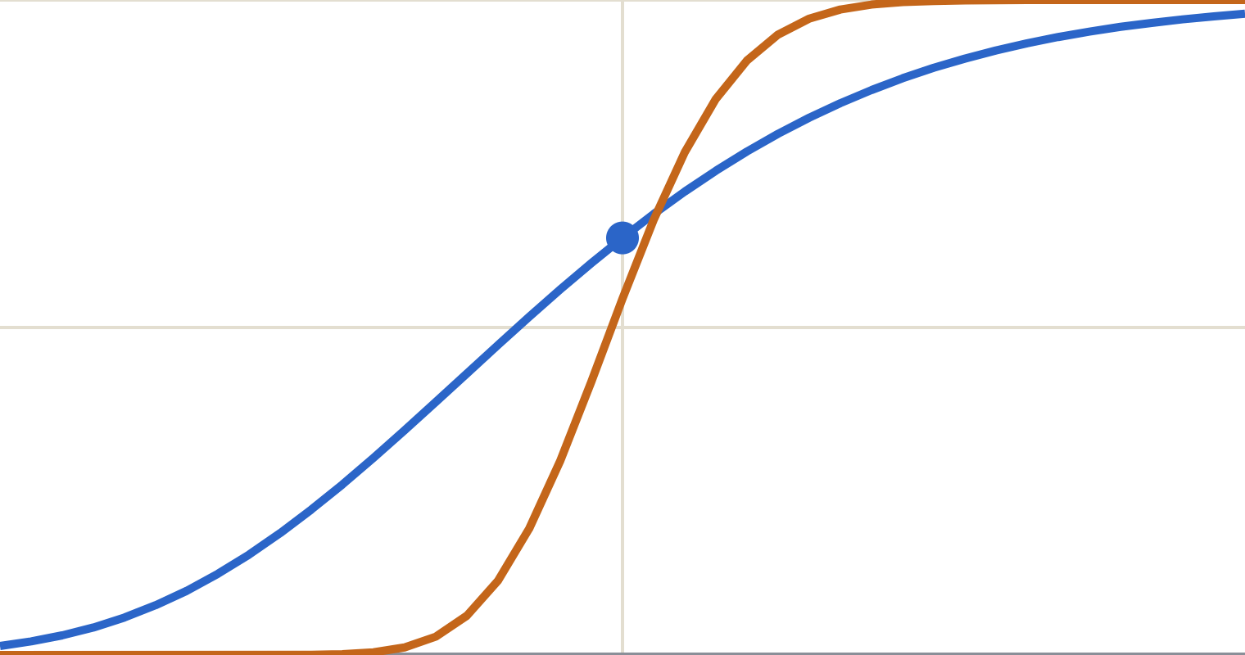
Delta: speed, hedge ratio, and a hint of probability
04 · USING THE LATTICE · GREEKS 2 OF 7
1
1 · Speed
Δ = 0.64: stock +1.00 → call +0.64. Like a car’s speed: how fast V moves with S.
.5
2 · Hedge ratio
Sold 100 calls? Buy 64 shares and small moves cancel. The tree’s root said 0.624.
━ 1 year left
━ about 1 month left
0
3 · “How in the money”
60
100
140
Δ → 1: behaves like the stock. Δ → 0: a lottery ticket. Near expiry it becomes a step: all or nothing.
stock price S · call delta
Notes:
Delta has three intuitions, and it's worth giving all three. First, speed: if the stock rises by one euro, our call rises by about 64 cents. Second, the hedge ratio: a bank that sold 100 of these calls buys 64 shares, and small stock moves then cancel out — this is exactly the delta we read off the lattice nodes, 0.624 at the root in our toy tree. Third, a rough sense of how likely the option is to pay off: deep in the money, delta approaches 1 and the call behaves like the stock itself; far out of the money it approaches zero and behaves like a lottery ticket. The chart shows delta across stock prices. With a year left, the curve is a gentle S. With a month left, it's almost a step at the strike: the option is close to all-or-nothing. That steepening is what the next Greek, gamma, measures.

Slide 63
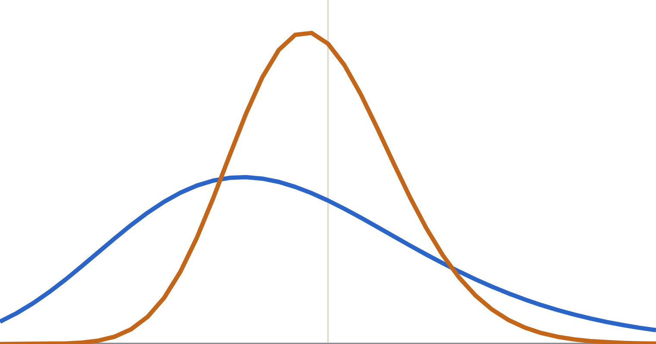
Gamma: acceleration — and why holders love big moves
04 · USING THE LATTICE · GREEKS 3 OF 7
1 · Acceleration
━ 1 year left
━ 3 months left
Γ = 0.019: stock +1 → delta +0.019. In the tree: Δ 0.29 at S = 90, 0.81 at S = 110.
2 · Hedging workload
High gamma = the hedge goes stale fast = rebalance often. Worst at the strike, near expiry.
3 · Convexity pays
60
100
140
gain ≈ ½ · Γ · (move)²
stock price S · call gamma (peaks at the strike K = 100)
Squared: up or down, a hedged holder gains from any move.
Notes:
If delta is speed, gamma is acceleration: how quickly delta changes as the stock moves. For our call, a one-euro rise lifts delta by about 0.019. You saw it on the lattice: delta was 0.29 at the lower t=1 node and 0.81 at the upper one. Gamma matters for two reasons. Practically, it's the hedger's workload: with high gamma, yesterday's hedge ratio is wrong today, so you must trade more often. The chart shows where that bites: gamma is a hump centred on the strike, and as expiry approaches it gets taller and narrower — an at-the-money option close to expiry is the hardest thing to hedge. Conceptually, gamma is convexity, and convexity pays: a delta-hedged option holder gains roughly one half gamma times the move squared. Because the move is squared, it doesn't matter whether the stock goes up or down — any move helps. That sounds like free money. The next slide shows who pays for it.

Slide 64
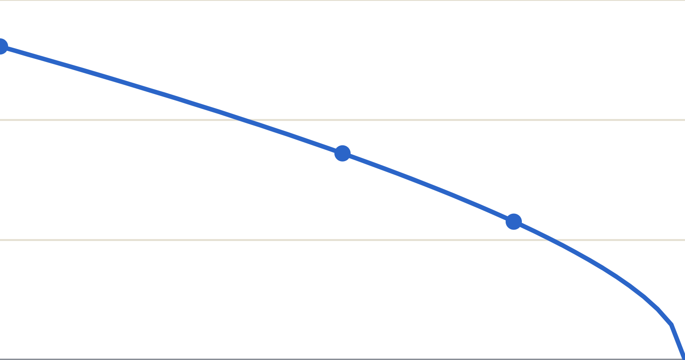
Theta: the melting ice cube — rent paid for gamma
04 · USING THE LATTICE · GREEKS 4 OF 7
12
1 · Time decay
10.45
Θ = −6.41 per year ≈ −0.018 per day: the cost of waiting, all else equal.
8
6.89
2 · Accelerates at the end
4.61
Less time = less chance to move. The last weeks melt fastest (1.18 with a week left).
4
3 · No free lunch
0
1 year left
6 months
expiry
Θ + ½σ²S²Γ + rSΔ = rV
ATM call value, stock held at 100: 10.45 → 6.89 → 4.61 → 0
The PDE again: gamma gains are paid for by theta, day by day.
Notes:
Theta is the cost of time. Hold the stock price fixed at 100 and just let the calendar run: our call is worth 10.45 with a year left, 6.89 with six months, 4.61 with three months, about 1.18 with a week, and zero at expiry. That's theta: minus 6.41 per year, or roughly 1.8 cents per day right now. Traders call it the melting ice cube, and notice how the melting speeds up at the end: an at-the-money option loses value fastest in its final weeks, because there's less and less time for the stock to move. The third card connects back to gamma. Rearranged, the Black-Scholes equation says theta plus the gamma term plus the delta term equals the bank return. In words: a delta-hedged option holder gains from convexity whenever the stock moves, and pays for it with theta every day. If the stock moves exactly as much as the volatility predicts, the two cancel. That's the deep trade-off of option books: long gamma means paying theta rent; short gamma means collecting rent and hoping the market stays quiet — which is exactly what Barings' trader was doing.

Slide 65
Vega and rho: sensitivity to the market’s mood and to rates
04 · USING THE LATTICE · GREEKS 5 OF 7
Vega · +0.38 per vol point
Rho · +0.53 per rate point
More uncertainty = more valuable. Upside is kept, downside is capped, so a wider spread only helps the holder.
A call lets you pay K later instead of buying the stock now; higher rates make paying later worth more. A put’s rho is negative.
σ 10%
6.80
Usually the smallest Greek for short-dated equity options, but large for long-dated and rate options.
σ 20%
10.45
σ 30%
14.23
ON THE LATTICE: BUMP AND REVALUE
Run it backwards: from a market price, solve for σ = implied volatility, the market’s “fear gauge” (VIX).
vega = (price(σ=.21) − price(σ=.19))/2 # 0.375
rho = (price(r=.06) − price(r=.04))/2 # 0.532
Notes:
The last two Greeks don't live on the lattice's nodes, because they change the tree itself. Vega is sensitivity to volatility: plus 38 cents for each extra percentage point of volatility. The bars show why intuition says options love uncertainty: at 10 percent volatility the call is worth 6.80, at 20 percent 10.45, at 30 percent 14.23. The holder keeps the upside and the downside is capped at the premium, so spreading out the possible outcomes can only help. In practice this runs the other way round: the market quotes option prices, and traders invert the formula to find the volatility that matches — implied volatility. The VIX index is essentially that number for the S&P 500, which is why it's called the fear gauge. Rho is sensitivity to interest rates: a call lets you delay paying the strike, and higher rates make delaying more valuable; for puts it's the opposite. For both, the lattice method is bump-and-revalue: rebuild the tree with a slightly higher and lower input and take the difference. The code comments show the results from 500-step trees, matching the closed-form values 0.375 and 0.532.

Slide 66

On the lattice: Δ, Γ, Θ for free from the nodes
04 · USING THE LATTICE · GREEKS 6 OF 7
DELTA · ∂V/∂S
GAMMA · ∂²V/∂S²
THETA · ∂V/∂T
0.624
0.026
−2.56
(C↑ − C↓)/(S↑ − S↓)
= (15.56 − 3.08)/20
(Δ↑ − Δ↓)/((S↑↑ − S↓↓)/2)
= (0.806 − 0.291)/20
(C(ud) − C₀)/(2 steps)
= (5.24 − 10.36)/2
Slope across the t = 1 nodes
Change in slope across t = 2
Per step; exact when d = 1/u
Vega and rho aren’t on the tree: bump σ or r, rebuild, and difference the two prices.
Notes:
The Greeks are the sensitivities a trading desk uses to manage risk, and the lattice gives three of them with no extra computation. Delta is the slope of value against stock price, read off the two t=1 nodes. Gamma is how fast delta changes, read off the t=2 nodes: the difference of the two deltas divided by the average stock spacing. Theta is time decay: compare the middle node two steps ahead with the root. In our toy tree the middle node is at 99, not 100, so theta is approximate; the calibrated tree with d equal one over u puts it exactly back at S-zero. Vega and rho change the tree itself, so they're computed by bump-and-revalue: rebuild with sigma plus a little and take the difference. These are also exactly the derivative terms that appear in the Black-Scholes PDE — keep that in mind.

Slide 67
Putting it together: the Greeks explain the P&L
04 · USING THE LATTICE · GREEKS 7 OF 7
change in V ≈ Δ·dS + ½Γ·dS² + Θ·dt + ν·dσ + ρ·dr
A Taylor expansion. Example: one day passes and the stock moves 100 → 102.
Term | Calculation | Contribution
Delta | 0.637 × 2 | +1.274
Gamma | ½ × 0.0188 × 2² | +0.038
Theta | −6.41 × 1/365 | −0.018
Greeks’ estimate |  | +1.294
Full repricing |  | +1.293
Bank risk reports are this table, summed over thousands of positions: a linearised model of the portfolio, refreshed many times a day.
Notes:
The Greeks come together in one line: the change in an option's value is approximately delta times the stock move, plus half gamma times the move squared, plus theta times the time elapsed, plus vega and rho times changes in volatility and rates. It's a Taylor expansion — a linearisation of the pricing function around today's inputs, the same idea as a gradient step. The table checks it on our example: one day passes and the stock rises from 100 to 102. Delta contributes 1.274, gamma adds 0.038, theta takes away 0.018. The Greeks predict plus 1.294; actually repricing the option with Black-Scholes gives plus 1.293. This is how risk is managed in practice: rather than repricing every scenario, risk systems aggregate the Greeks across all positions, and traders read the result as "we're long so much delta, short so much gamma, we lose so much per day from theta". It's also why a pricing model is not just a price engine: its derivatives are the product.

Slide 68
American put: exercise or wait, at every node
04 · USING THE LATTICE · AMERICAN OPTIONS
The holder may exercise any time. The backward step gains one max:
t = 0
t = 1
t = 2
t = 3 = T
133.10
P = 0.00
V = max( K − S, [q·V↑+(1−q)·V↓]/R )
exercise vs continue
121.00
P = 0.00
110.00
P = 1.68
108.90
P = 0.00
Put, K = 100. At S = 81: exercise 19.00 beats continue 17.04. At S = 90: 10.00 beats 9.97.
100.00
P = 4.91
99.00
P = 4.27
90.00
10.00 ex
89.10
P = 10.90
81.00
19.00 ex
72.90
P = 27.10
Notes:
Here's where the lattice earns its keep. An American option can be exercised at any time before expiry, and there's no closed-form Black-Scholes price for an American put. On the lattice, the fix is one max: at each node compare what you'd get by exercising now, K minus S, with the value of waiting, which is the usual discounted expectation. Keep the larger. In our example, two nodes flip to exercise, shown in orange with "ex": at S equals 81 exercising pays 19 versus 17.04 for waiting, and at S equals 90 it pays 10 versus 9.97. Why exercise a put early? Because receiving the strike now lets you earn interest on it; when the put is deep in the money that interest outweighs the remaining optionality. Those exercise nodes trace out the early-exercise boundary.

Slide 69
The right to choose has a price
04 · USING THE LATTICE · AMERICAN OPTIONS
EUROPEAN PUT
AMERICAN PUT
AMERICAN CALL
4.59
4.91
10.36
Same tree, no max
Early-exercise premium +0.32
= European: never exercise early without dividends
Sanity check: put-call parity
Realistic tree, n = 1000
C − P = S₀ − K/R³
10.36 − 4.59 = 100 − 94.23 = 5.77 ✓
S=K=100, r=5%, σ=20%, T=1
European 5.57 · American 6.09
Notes:
Put numbers on it. The American put is worth 4.91 against 4.59 for its European twin: the 0.32 difference is the value of the right to choose when to exercise. The American call, by contrast, is worth exactly the European 10.36. Without dividends it's never optimal to exercise a call early — you'd give up the time value and pay the strike sooner than necessary — so the max never bites. Put-call parity, which holds for European options regardless of model, confirms the European numbers. On the right, the same code with a realistic 1000-step calibrated tree: the early-exercise premium is about 0.52. There's no closed formula for that 6.09; the lattice is the industry's classic tool for it.

Slide 70
Calibrate the lattice to σ and r (Cox-Ross-Rubinstein)
05 · BACK TO BLACK-SCHOLES
TIME STEP
MOVE SIZES
RISK-NEUTRAL WEIGHT
Δt = T / n
u = e^(σ√Δt)
d = 1/u
q = (e^(rΔt) − d) / (u − d)
More steps, finer grid in time.
Log-return variance per step = σ²Δt. The tree recombines around S₀.
Expected growth per step is exactly e^(rΔt).
σ = 20%, r = 5%, T = 1, n = 4 :
Δt = 0.25 · u = 1.1052 · d = 0.9048 · q = 0.5378
Notes:
To connect the toy tree to the real world, we choose u, d and q so that each step matches the continuous model over the same time interval. Volatility sets the size of the moves: u equals e to the sigma root delta t, so the variance of the log-return per step is sigma squared delta t — exactly as in geometric Brownian motion. Choosing d as one over u makes the tree symmetric in log space, so up-down returns to S-zero. And q is the same formula we derived from replication, now with R equals e to the r delta t. By construction the expected stock price under q grows at the risk-free rate in every step. Note the square root: moves shrink like root delta t, not delta t. That is the signature of Brownian motion, and it's what makes the next slide work.

Slide 71
The backward step is the Black-Scholes PDE, discretised
05 · BACK TO BLACK-SCHOLES · BACKWARD
1
R·V(t, S) = q·V(t+Δt, uS) + (1−q)·V(t+Δt, dS)
the lattice rule
2
Taylor-expand, using E_q[ΔS] ≈ rSΔt and E_q[ΔS²] ≈ σ²S²Δt:
RHS ≈ V + (∂V/∂t + rS·∂V/∂S + ½σ²S²·∂²V/∂S²)·Δt
first two moments of one step under q
3
LHS ≈ V + rV·Δt. Cancel V, divide by Δt, let Δt → 0:
R = e^(rΔt) ≈ 1 + rΔt
∂V/∂t + r·S·∂V/∂S + ½·σ²·S²·∂²V/∂S² − r·V = 0
Notes:
Here's the first half of the Black-Scholes parallel, and it's just a Taylor expansion. Start from the lattice rule: discount factor times today's value equals the q-weighted average of tomorrow's two values. Expand the two future values around today's node. Because the up and down moves are of size sigma root delta t, the first-order term in the stock move averages to r S delta t under q, and the second-order term averages to sigma squared S squared delta t — the variance — so it survives at order delta t. Higher terms vanish faster. Match both sides, divide by delta t, and take the limit: out comes the Black-Scholes PDE term for term. The time-decay term is theta, the first derivative is delta, the curvature term is gamma — the same three Greeks we read off the nodes. In numerical-analysis language, the binomial lattice is an explicit finite-difference scheme for the Black-Scholes PDE on a log-price grid.

Slide 72
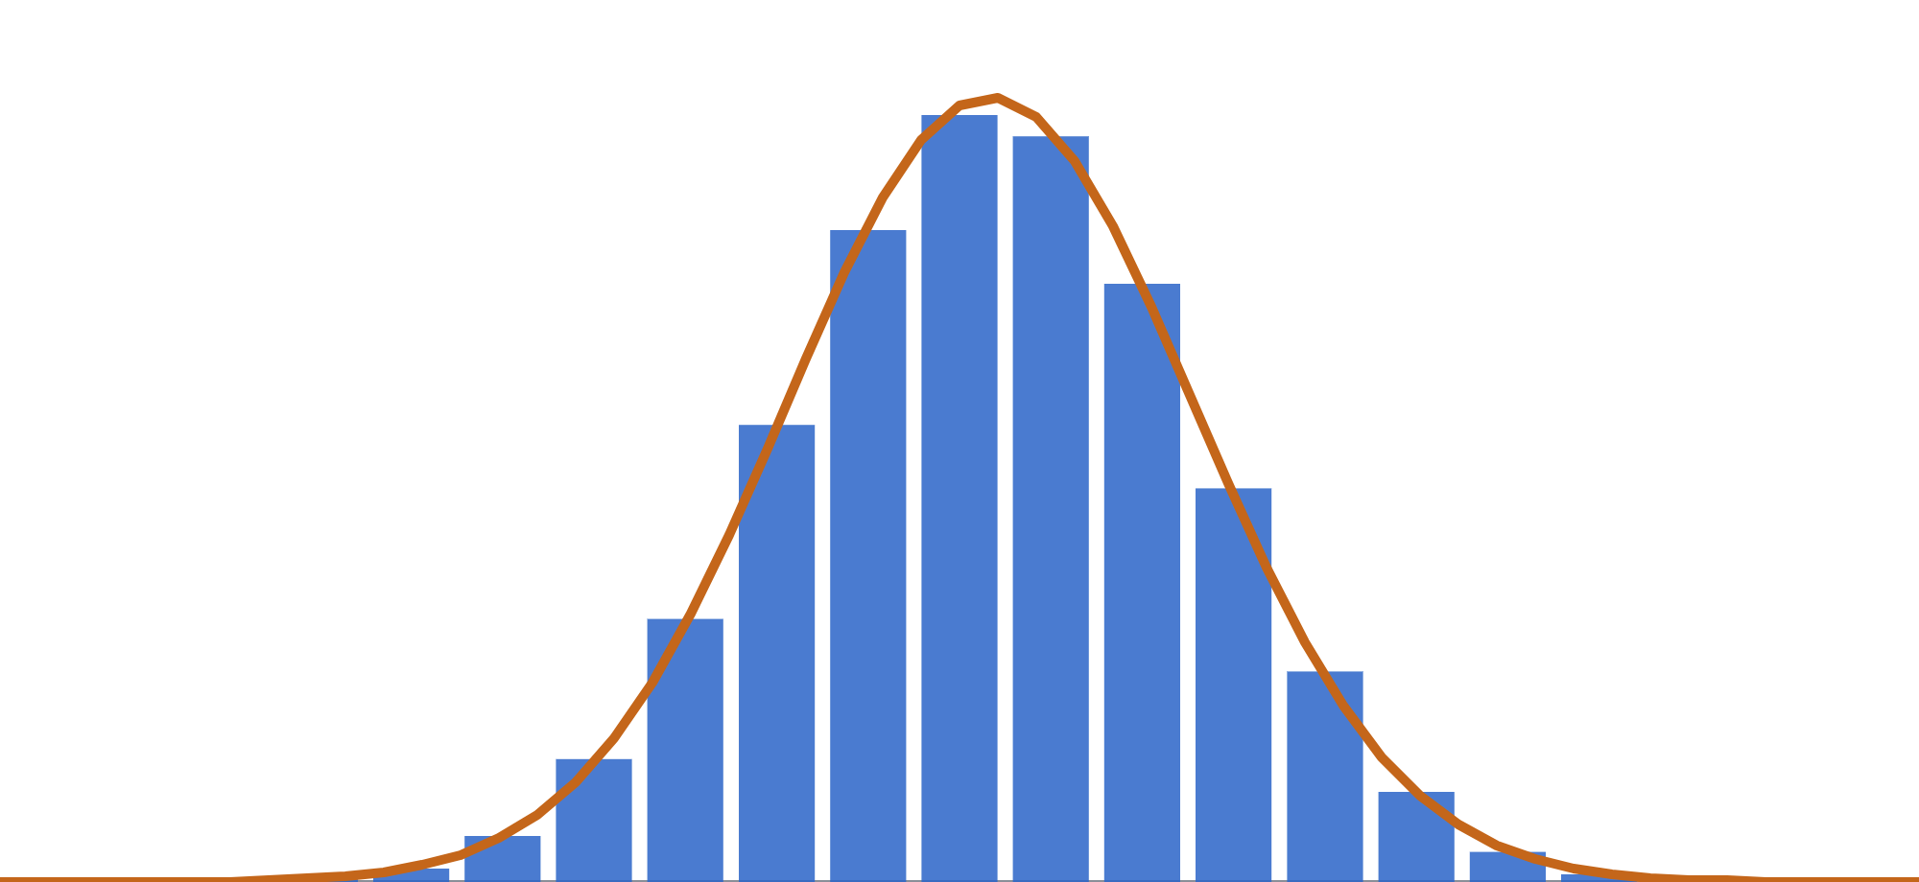
The forward pass converges to the lognormal
05 · BACK TO BLACK-SCHOLES · FORWARD
Forward-propagating q gives a binomial count of up-moves at T.
■ lattice, q-probabilities
━ normal density of ln S(T)
By the central limit theorem, ln S(T) becomes normal: mean ln S₀ + (r − σ²/2)T, variance σ²T.
That is geometric Brownian motion under Q — Black-Scholes’ assumption.
40.9
63.9
100
156.4
244.6
S(T), log scale · n = 20 · σ = 20% · r = 5% · T = 1
Notes:
The second half of the parallel is about the forward pass. Propagate the risk-neutral probabilities forward through a 20-step calibrated tree and plot the mass that lands on each leaf, using a log axis for the stock price. The bars are the lattice; the orange curve is the normal density that Black-Scholes assumes for the log of the terminal price, with mean log S-zero plus r minus half sigma squared times T and variance sigma squared T. Even at 20 steps they're nearly indistinguishable. That's the central limit theorem: the log-price is a sum of n independent plus-or-minus sigma root delta t steps. So the forward pass converges to the lognormal distribution, and in continuous time the forward-propagation rule becomes the Fokker-Planck equation.

Slide 73

The lattice sum splits into the two Black-Scholes terms
05 · BACK TO BLACK-SCHOLES · THE FORMULA
BINOMIAL CALL PRICE · A = FEWEST UP-MOVES THAT FINISH ABOVE K
C₀ = S₀·P[Bin(n, q′) ≥ a] − K·R⁻ⁿ·P[Bin(n, q) ≥ a], q′ = q·u/R
n → ∞ (CLT on each binomial)
C = S·N(d₁) − K·e^(−rT)·N(d₂)
N(d₂): risk-neutral chance of finishing in the money. N(d₁): the same with the stock as unit of account — and the hedge Δ.
Toy tree check (n = 3, a = 2): 100·0.7142 − 94.23·0.6480 = 71.42 − 61.06 = 10.36 ✓
Notes:
Now the formula itself. Take the closed-form binomial sum from the two-routes slide and keep only the leaves that finish in the money — those with at least a up-moves. Split the payoff S minus K into two pieces. The K piece is K, discounted, times the q-probability of finishing in the money. The S piece can be rewritten as S-zero times a probability under a tilted weight q-prime, which is q times u over R. Each piece is a binomial tail probability, and by the central limit theorem each tail converges to a normal CDF: N of d2 and N of d1. That's Black-Scholes term for term. Check it on our toy tree: q-prime is 0.647, the tail probabilities are 0.714 and 0.648, and the result is our 10.36. N of d1 is also the continuous-time delta, the limit of the node hedge ratio.

Slide 74
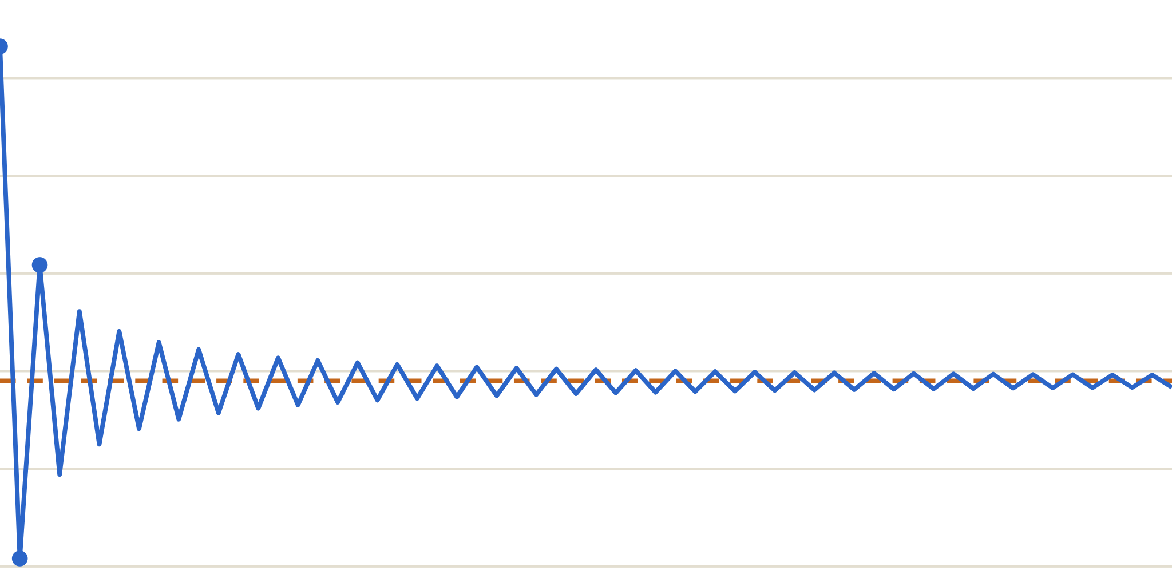
More steps, closer to 10.4506
05 · BACK TO BLACK-SCHOLES · CONVERGENCE
n | price
1 | 12.1623
10 | 10.2534
100 | 10.4306
1000 | 10.4486
BS | 10.4506
12.0
n = 1 → 12.16
11.5
11.0
Black-Scholes 10.4506
10.5
Error shrinks roughly like 1/n. The odd/even zig-zag comes from where K falls between leaves.
10.0
9.5
1
10
20
30
40
50
60
steps n
Notes:
Here's the proof in numbers, for the example from the Black-Scholes slide: S and K at 100, five percent rate, twenty percent vol, one year. With a single step the lattice says 12.16 — crude. By ten steps it's 10.25, by a hundred 10.43, by a thousand 10.4486 against the Black-Scholes 10.4506. The convergence is roughly first order in one over n. The saw-tooth pattern between odd and even n is a well-known artefact: depending on n, the strike sits on a leaf or between two leaves, so the payoff kink is sampled differently. Practitioners smooth this out by averaging n and n plus one, or by aligning a node with the strike.

Slide 75
A dictionary: lattice ↔ Black-Scholes
05 · BACK TO BLACK-SCHOLES · SUMMARY
Concept | Lattice (discrete) | Black-Scholes (continuous)
Time | n steps of Δt = T/n | continuous t, dt → 0
Randomness | × u or × d, u = e^(σ√Δt) | dS = rS·dt + σS·dW
Pricing weights | q = (R − d)/(u − d) | risk-neutral measure Q, drift r
Forward pass | binomial probabilities, state prices ψ | lognormal density, Fokker-Planck
Backward pass | V = [q·V↑ + (1−q)·V↓]/R | BS PDE, solved from payoff at T
Hedge | Δ = (V↑ − V↓)/(S↑ − S↓) | Δ = ∂V/∂S = N(d₁) for a call
Price | binomial sum over the leaves | S·N(d₁) − K·e^(−rT)·N(d₂)
Early exercise | max(exercise, continue) per node | free-boundary problem, no closed form
Notes:
Use this as the reference card to take away. Every row is a one-to-one correspondence: time steps become dt, the up-down moves become Brownian increments, q becomes the risk-neutral measure, the forward pass becomes the lognormal density and its evolution equation, the backward pass becomes the PDE, the node hedge becomes the partial derivative, and the binomial sum becomes the formula. The last row is where the lattice is strictly more practical: early exercise is a trivial max on the tree but a free-boundary problem in continuous time with no closed-form solution.

Slide 76
Five things to remember
TAKEAWAYS
1
Price by replication, not prediction. The real-world p never enters.
2
q = (R − d)/(u − d) is a pricing device. A world where everything grows at r.
3
Forward builds the stage, backward computes value. Prices, probabilities, state prices → ; values ←.
4
Nodes give hedges and Greeks; one max gives American options.
5
Shrink Δt and the lattice is Black-Scholes. Backward step → PDE; binomial → lognormal; sum → N(d₁), N(d₂).
Notes:
Close by going around the five points. The deepest idea is the first one: we never had to agree on where the stock is going, because the option can be built from stock and cash. The second is the vocabulary: risk-neutral probabilities are a computational device, not a forecast. The third is the picture we drew over and over: arrows right to generate the tree, arrows left to value it. The fourth is why practitioners still use lattices: hedges, Greeks and early exercise come almost for free. And the fifth closes the loop: Black-Scholes is what this lattice becomes when the steps get infinitely small. Suggested exercise: implement the price function, reproduce 10.36 on the toy tree, then plot convergence yourself.

Slide 77

Options changed how the world manages risk
A FINAL WORD
Options trading gave businesses and investors more ways to protect against adverse price moves, supporting economic activity under uncertainty.
Leveraged positions can also magnify losses and transmit stress through financial markets.
— The End —
Notes:
Closing perspective: Options are one class of derivatives. Their economic contribution is the ability to transfer and tailor risk. This is a qualitative conclusion, not an estimate of their causal contribution to world GDP. Benefits depend on hedging design, leverage, counterparty exposure and risk management.
[Sources]
BIS, International finance through the lens of BIS statistics: derivatives markets, 8 December 2025. Risk redistribution, hedging and speculation in the global financial system.
https://www.bis.org/publications/qr-202512/international-finance-through-lens-bis-statistics-derivatives-markets
Acharya, Brenner, Engle, Lynch and Richardson, Derivatives – The Ultimate Financial Innovation. Benefits and risks of derivatives, including options.
https://pages.stern.nyu.edu/~mbrenner/research/derivatives.pdf
CQF, Hedging with Options: What You Need to Know. Options as protection against adverse price movements.
https://www.cqf.com/blog/hedging-options-what-you-need-know
Illustration: AI-generated conceptual globe and options lattice. Decorative, not market data.
[/Sources]

